Slide 1
MODULE III
B.Tech. CSE
Semester VI
Viswajyothi College of Engineering

Slide 2
Syllabus
I/O Basics
  Byte Streams and Character Streams
  Reading Console Input
Collections Framework
Applets & Applet Architecture
  Applet Skelton
  Passing Parameters to Applet
Event Handling
  Event Model
  Event Classes
  Event Listener Interfaces
AWT
  AWT Classes
  AWT Controls
  Layout Managers and Menus.
Swing
  JApplet
  Jbuttons
  JTables

Slide 3
IO Basics : Streams
Java programs perform I/O through streams.
A stream is an abstraction that either produces or consumes information.
A stream is linked to a physical device by the Java I/O system.
All streams behave in the same manner, even if the actual physical devices to which they are linked differ. Thus, the same I/O classes and methods can be applied to any type of device.
Java implements streams within java.io package.

Slide 4
Streams
Two types of streams:
  Byte Stream
    Used for reading or writing binary data.
  CharacterStream
    Used for handling input and output of characters.
    They use unicode.
At the lowest level, all I/O is byte-oriented.
Import java.io.* to use any of the stream classes

Slide 5
Byte Streams Classes
Two classes for Byte streams :
  InputStream
  OutputStream
These classes define several key methods that the other stream classes implement.
Eg: read( ) and write( ), which, respectively, read and write bytes of data. Both methods are declared as abstract. They are overridden by derived stream classes.
Each of these abstract classes has several concrete subclasses, that handle various devices, such as disk files, network connections, memory buffers etc.

Slide 6
Byte Stream Classes
Stream Class | Meaning
BufferedInputStream | Buffered input stream
BufferedOutputStream | Buffered output stream
ByteArrayInputStream | Input stream that reads from a byte array
ByteArrayOutputStream | Output stream that writes to a byte array
DataInputStream | An input stream that contains methods for reading the Java standard data types
DataOutputStream | An output stream that contains methods for writing the Java standard data types
FileInputStream | Input stream that reads from a file
FileOutputStream | Output stream that writes to a file
FilterInputStream | Implements InputStream
FilterOutputStream | Implements OutputStream
InputStream | Abstract class that describes stream input
OutputStream | Abstract class that describes stream output
PipedInputStream | Input pipe
PipedOutputStream | Output pipe
PrintStream | Output stream that contains print( ) and println( )
PushbackInputStream | Input stream that supports one-byte “unget,” which returns a byte to the input stream
RandomAccessFile | Supports random access file I/O
SequenceInputStream | Input stream that is a combination of two or more input streams that will be read sequentially, one after the other

Slide 7
Character Stream Classes
Two classes for Character streams :
  Reader
  Writer
These abstract classes handle Unicode character streams.
These classes define several key methods that the other stream classes implement.
Eg: read() and write(), which read and write characters of data, respectively. These methods are overridden by derived stream classes.

Slide 8
Character Stream Classes
Stream Class | Meaning
BufferedReader | Buffered input character stream
BufferedWriter | Buffered output character stream
CharArrayReader | Input stream that reads from a character array
CharArrayWriter | Output stream that writes to a character array
FileReader | Input stream that reads from a file
FileWriter | Output stream that writes to a file
FilterReader | Filtered reader
FilterWriter | Filtered writer
InputStreamReader | Input stream that translates bytes to characters
LineNumberReader | Input stream that counts lines
OutputStreamWriter | Output stream that translates characters to bytes
PipedReader | Input pipe
PipedWriter | Output pipe
PrintWriter | Output stream that contains print( ) and println( )
PushbackReader | Input stream that allows characters to be returned to the input stream
Reader | Abstract class that describes character stream input
StringReader | Input stream that reads from a string
StringWriter | Output stream that writes to a string
Writer | Abstract class that describes character stream output

Slide 9
Predefined Streams
java.lang package defines a class called System.
System contains three predefined public and static stream variables: in, out, and err
  System.out refers to the standard output stream. By default, this is the console.
  System.in refers to standard input stream, which is the keyboard by default.
  System.err refers to the standard error stream, which also is the console by default.
System.in is an object of type InputStream
System.out and System.err are objects of type PrintStream

Slide 10
Reading Console Inputs
Console input is accomplished by reading from System.in.
The following line of code creates a BufferedReader that is connected to the keyboard:
BufferedReader br = new BufferedReader(new
InputStreamReader(System.in));
Now br is a character-based stream that is linked to the console through System.in.
System.in - console input byte stream
        InputStreamReader - converts bytes to char

Slide 11
Reading Console Inputs : Reading a Character
read( )
int read( ) throws IOException
Reads a character from the input stream and returns an integer value.
It returns –1 when the end of the stream is encountered.

Slide 12
import java.io.*; class BRRead { public static void main(String args[]) throws IOException { char c; BufferedReader br = new BufferedReader(new InputStreamReader(System.in)); System.out.println("Enter characters, 'q' to quit."); do { c = (char) br.read(); System.out.println(c); } while(c != 'q'); } }
Output: Enter characters, 'q' to quit. 123abcq 1 2 3 a b c q

Slide 13
Reading Console Inputs : Reading a String
readLine( )
String readLine( ) throws IOException
import java.io.*; class BRReadLines { public static void main(String args[]) throws IOException { BufferedReader br = new BufferedReader(new InputStreamReader(System.in)); String str; System.out.println("Enter lines of text."); System.out.println("Enter 'stop' to quit."); do { str = br.readLine(); System.out.println(str); } while(!str.equals("stop")); } }

Slide 14
//A tiny Text Editor import java.io.*; class TinyEdit { public static void main(String args[]) throws IOException { BufferedReader br = new BufferedReader(new InputStreamReader(System.in)); String str[] = new String[100]; System.out.println("Enter lines of text."); System.out.println("Enter 'stop' to quit."); for(int i=0; i<100; i++) { str[i] = br.readLine(); if(str[i].equals("stop")) break; } System.out.println("\nHere is your file:"); for(int i=0; i<100; i++) { if(str[i].equals("stop")) break; System.out.println(str[i]); } } }

Slide 15
Writing Console Outputs
PrintStream implements write( ). write( ) can be used to write to the console.
void write(int byteval)
This method writes to the stream the byte specified by byteval.
byteval is declared as an integer, only the low-order eight bits are written.
class WriteDemo { public static void main(String args[]) { int b; b = 'A'; System.out.write(b); System.out.write('\n'); } }

Slide 16
PrintWriter Class
The recommended method of writing to the console is through a PrintWriter stream.
PrintWriter is the character-based classes.
PrintWriter(OutputStream outputStream, boolean flushOnNewline)
flushOnNewline controls whether Java flushes the output stream every time a println( ) method is called. If flushOnNewline is true, flushing automatically takes place. If false, flushing is not automatic.
PrintWriter pw = new PrintWriter(System.out, true);

Slide 17
import java.io.*; public class PrintWriterDemo { public static void main(String args[]) { PrintWriter pw = new PrintWriter(System.out, true); pw.println("This is a string"); int i = -7; pw.println(i); double d = 4.5e-7; pw.println(d); } }
Output: This is a string -7 4.5E-7

Slide 18
Reading and Writing a File
In Java, all files are byte-oriented.
The stream classes used for file operations are
  FileInputStream and FileOutputStream
To open a file :
FileInputStream(String fileName) throws FileNotFoundException
FileOutputStream(String fileName) throws FileNotFoundException
fileName specifies the name of the file that we want to open.
If the file does not exist, then FileNotFoundException is thrown.
For output streams, if the file cannot be created, then FileNotFoundException is thrown.
When an output file is opened, any preexisting file by the same name is destroyed.

Slide 19
Reading and Writing a File
close() method is used to close a file.
It is defined by both FileInputStream and FileOutputStream
void close( ) throws IOException
read( ) : To read from a file, defined by FileInputStream
int read( ) throws IOException
It reads a single byte from the file and returns the byte as an integer value. read( ) returns –1 when the end of the file is encountered.
write( ) : To write to a file, defined by FileOutputStream.
void write(int byteval) throws IOException
Writes the byte specified by byteval to the file. If an error occurs during writing, an IOException is thrown.

Slide 20
import java.io.*; class ShowFile { public static void main(String args[]) throws IOException { int i; FileInputStream fin; try { fin = new FileInputStream(args[0]); } catch(FileNotFoundException e) { System.out.println("File Not Found"); return; } catch(ArrayIndexOutOfBoundsException e) { System.out.println("Usage: ShowFile File"); return; } do { i = fin.read(); if(i != -1) System.out.print((char) i); } while(i != -1); fin.close(); } }

Slide 21
import java.io.*; class CopyFile { public static void main(String args[]) throws IOException { int i; FileInputStream fin; FileOutputStream fout; try { try { fin = new FileInputStream(args[0]); } catch(FileNotFoundException e) { System.out.println("Input File Not Found"); return; } try { fout = new FileOutputStream(args[1]); } catch(FileNotFoundException e) { System.out.println("Error Opening Output File"); return; } } catch(ArrayIndexOutOfBoundsException e) { System.out.println("Usage: CopyFile From To"); return; } try { do { i = fin.read(); if(i != -1) fout.write(i); } while(i != -1); } catch(IOException e) { System.out.println("File Error"); } fin.close(); fout.close(); } }

Slide 22
Syllabus
I/O Basics
  Byte Streams and Character Streams
  Reading Console Input
Collections Framework
Applets & Applet Architecture
  Applet Skelton
  Passing Parameters to Applet
Event Handling
  Event Model
  Event Classes
  Event Listener Interfaces
AWT
  AWT Classes
  AWT Controls
  Layout Managers and Menus.
Swing
  JApplet
  Jbuttons
  JTables

Slide 23
Collections Framework
A standard which defines how a group of objects are handled in your program.
Eg:- Linked List, Hash Table, Tree Set etc…
In java.util

Slide 24
Collections Framework - Goals
High Performance
High Degree of inter operability among collections
Various algorithms to manipulate the collections
Extending/adapting collection had to be easy
Integration of standard arrays to collection framework
Algorithms as static methods
An iterator interface allows to access elements in the collection in a standard way
Several map interface and classes

Slide 25
«interface»
Collection
«interface»
Map
«interface»
Set
«interface»
List
«interface»
Queue
«interface»
SortedMap
HashSet
«interface»
SortedSet
Vector
ArrayList
LinkedList
TreeMap
HashMap
Linked
HashSet
TreeSet
Implementations

Slide 26
Various Collection Interfaces
Collection
List
Set
SortedSet
Comparator
Iterator & ListIterator
RandomAccess

Slide 27
Collection
Foundation in which collection framework is built
Several Methods are declared
Several methods throw
UnsupportedOperationException
ClassCastException

Slide 28
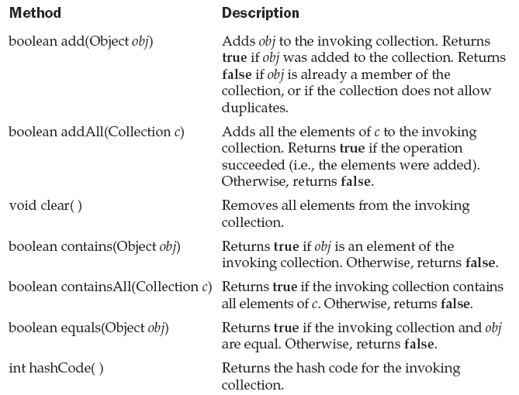

Slide 29
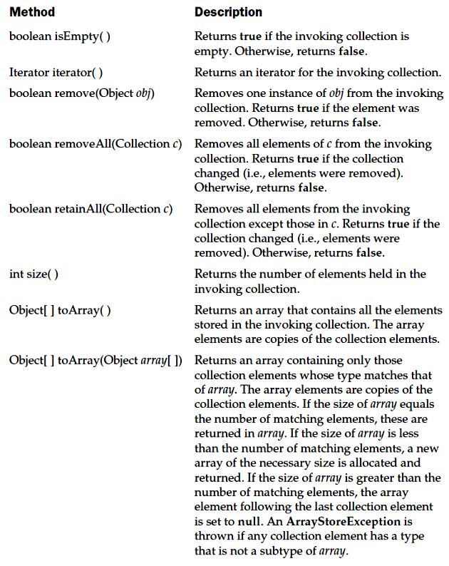

Slide 30
List
Extends the collection
Stores a sequence of elements
Elements can be accessed/inserted by position using a zero based index
Several methods throw
UnsupportedOperationException
ClassCastException

Slide 31
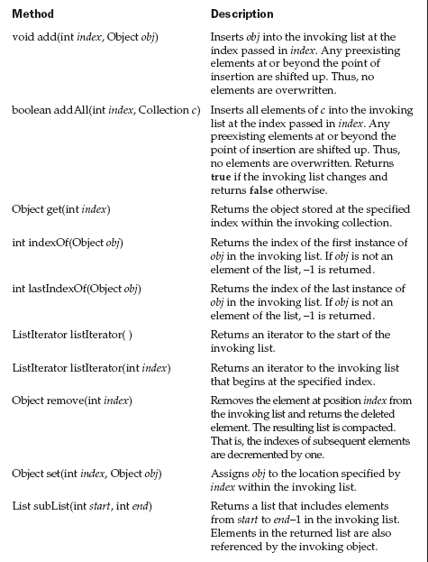

Slide 32
Set
Extends Collection
No additional methods
Set of elements without duplicate elements

Slide 33
SortedSet
Extends Set
Set in sorted way ie Ascending order
Several methods throw
NoSuchElementException
ClassCastException
NullPointerException

Slide 34
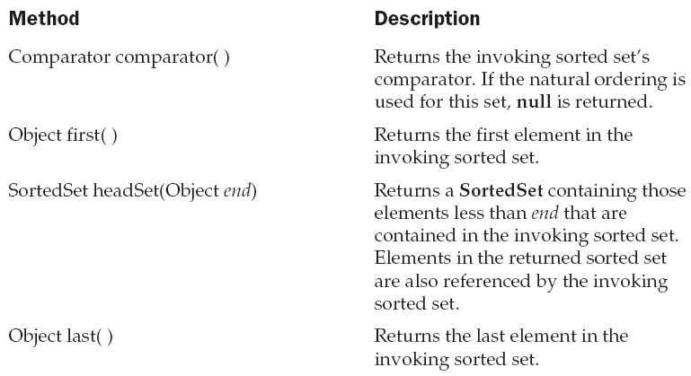
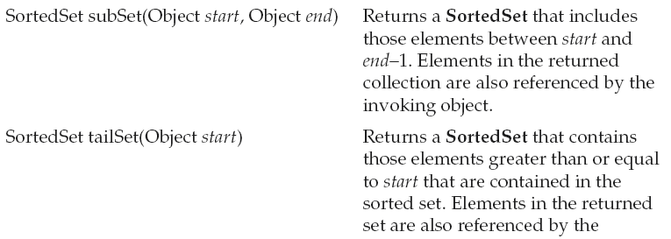

Slide 35
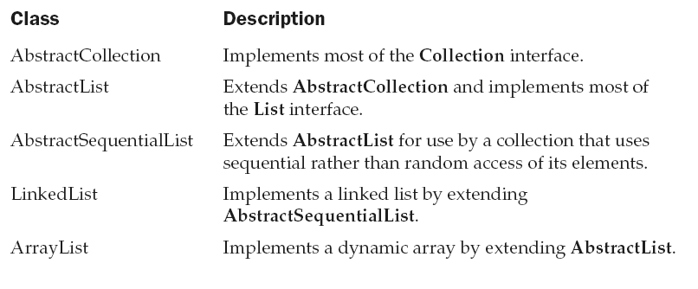
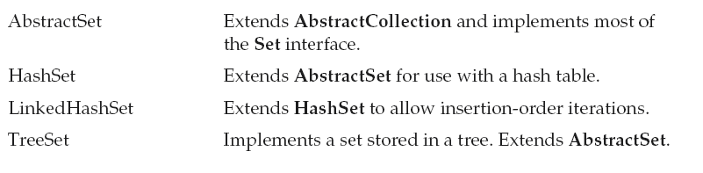
Collection Classes
Standard classes that implement the interfaces

Slide 36
The ArrayList Class
Extends AbstractList and Implements List
Supports dynamic array that can grow/shrink
ArrayList constructors
ArrayList()
ArrayList(Collection c)
ArrayList(int capacity)
Other methods:-
void ensureCapacity(int cap)
void trimToSize()

Slide 37
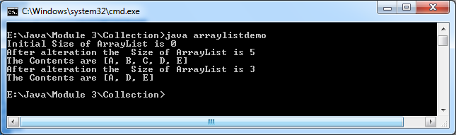
import java.util.*;
class arraylistdemo
{
public static void main(String args[])
{
ArrayList al=new ArrayList();
System.out.println("Initial Size of ArrayList is "+al.size());
al.add("A");
al.add("B");
al.add("C");
al.add("D");
al.add("E");
System.out.println("After alteration the Size of ArrayList is "+al.size());
System.out.println("The Contents are "+al);
al.remove("B");
al.remove(1);
System.out.println("After alteration the Size of ArrayList is "+al.size());
System.out.println("The Contents are "+al);
}
}

Slide 38
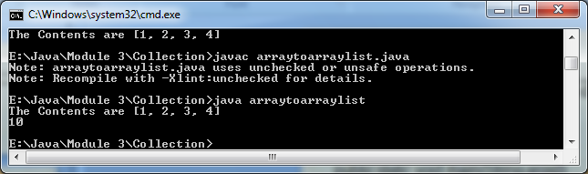
Obtaining an array from ArrayList
import java.util.*;
class arraytoarraylist
{
public static void main(String args[])
{
ArrayList al=new ArrayList();
al.add(new Integer(1));
al.add(new Integer(2));
al.add(new Integer(3));
al.add(new Integer(4));
System.out.println("The Contents are "+al);
Object temp[]=al.toArray();
int sum=0;
for(int i=0;i<temp.length;i++)
sum+=((Integer)temp[i]).intValue();
System.out.println(sum);
}
}

Slide 39
LinkedList Class
Extends AbstractSequentialList implements List
Constructors
LinkedList()
LinkedList(Collection c)

Slide 40
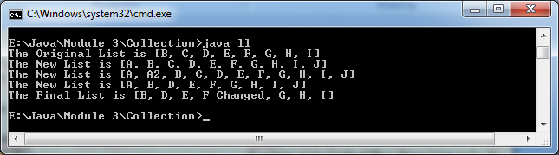
System.out.println("The Original List is "+ l);
l.addFirst("A");
l.addLast("J");
System.out.println("The New List is "+ l);
l.add(1, "A2");
System.out.println("The New List is "+ l);
l.remove("A2");
l.remove(2);
System.out.println("The New List is "+ l);
l.removeFirst();
l.removeLast();
Object val=l.get(3);
l.set(3, (String) val +" Changed");
System.out.println("The Final List is "+ l);
}
}
import java.util.*;
class ll
{
public static void main(String args[])
{
LinkedList l=new LinkedList();
l.add("B");
l.add("C");
l.add("D");
l.add("E");
l.add("F");
l.add("G");
l.add("H");
l.add("I");

Slide 41
HashSet
Extends AbstractSet implements Set
Use Hash table for storage
Key Hash code
Hash code is used as the index at which data associated with key is stored

Slide 42
Constructors
HashSet()
HashSet(Collection c)
HashSet(int capacity)
HashSet(int capacity, float fillratio)

Slide 43
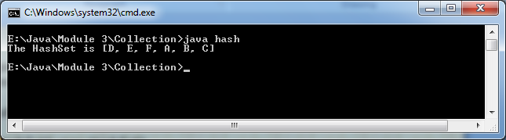
import java.util.*;
class hash
{
public static void main(String args[])
{
HashSet h=new HashSet();
h.add("B");
h.add("A");
h.add("D");
h.add("E");
h.add("C");
h.add("F");
System.out.println("The HashSet is "+ h);
}
}

Slide 44
LinkedHashSet
Extends HashSet
Maintains a linked list of the entries in the set based on order of insertion
Output for previous program using LinkedHashSet
[B, A, D, E, C, F]

Slide 45
TreeSet Class
Implements Set that uses tree for storage
Elements are stored in ascending order
Constructors
TressSet()
TreeSet(Collection c)
TreeSet(Comparator comp)
TreeSet(SortedSet s)

Slide 46
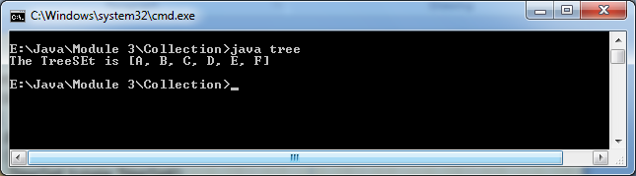
import java.util.*;
class tree
{
public static void main(String args[])
{
TreeSet t=new TreeSet();
t.add("B");
t.add("A");
t.add("D");
t.add("E");
t.add("C");
t.add("F");
System.out.println("The TreeSEt is "+ t);
}
}

Slide 47
Accessing a collection via Iterator
Employ iterator/ListIterator interface to traverse the list, remove or add elements
Iterator obtains or removes elements
ListIterator allows bidirectional traversal and modification of elements

Slide 48
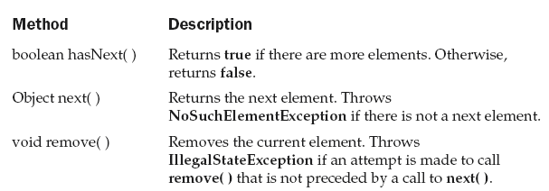
Methods in Iterator

Slide 49
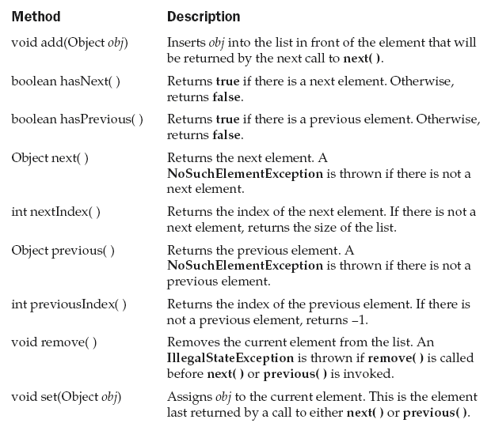
Methods in ListIterator

Slide 50
To iterate
In all collections there is a iterator method
Steps:-
Obtain an iterator to the start of the collection by calling the collection’s iterator()
Set up a loop that makes a call to hasNext() which returns true or false
Traverse each element using next() function

Slide 51
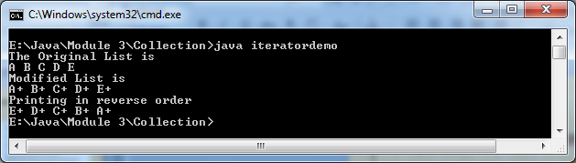
import java.util.*;
class iteratordemo
{
public static void main(String args[])
{
ArrayList al=new ArrayList();
al.add("A");
al.add("B");
al.add("C");
al.add("D");
al.add("E");
System.out.println("The Original List is ");
Iterator itr=al.iterator();
while(itr.hasNext())
{
Object element=itr.next();
System.out.print(element +" ");
}
ListIterator ltr=al.listIterator();
while(ltr.hasNext())
{
Object element=ltr.next();
ltr.set(element+"+");
}
System.out.println("\nModified List is ");
itr=al.iterator();
while(itr.hasNext())
{
Object element=itr.next();
System.out.print(element +" ");
}
System.out.println("\nPrinting in reverse order");
while(ltr.hasPrevious())
{
Object element=ltr.previous();
System.out.print(element +" ");
}
}
}

Slide 52
Storing user defined classes in collections
class address
{
public static void main(String args[])
{
LinkedList l=new LinkedList();
l.add(new mailing("J.W West","11 Oack Ave","Urbana“,
"Georgia“ ,"678934"));
l.add(new mailing("Ralph Baker","1421 Maple Lane",
"Mahomet","Washington","672213"));
l.add(new mailing("Tom Carlton","867 Elm Street",
"Champaign","IL","687543"));
Iterator itr=l.iterator();
while(itr.hasNext())
{
Object element=itr.next();
System.out.print(element +"\n");
}
}
}
import java.util.*;
class mailing
{
String name;
String street;
String city;
String state;
String zip;
mailing(String n, String s,
String c, String st, String z)
{
name=n;
street=s;
city=c;
state=st;
zip=z;
}
public String toString()
{
return name + "\n" +street+"\n"+city+"\n"+state+"\n"+zip+"\n\n";
}
}

Slide 53
Maps
An object which stores association with keys and values
Keys and values are objects
Keys must be unique, values can be duplicated

Slide 54
Map Interfaces
Map
SortedMap
Map.Entry

Slide 55
Map Interface
Given a key and value you can store the value in Map object
After the value is stored,you can retrieve it using the key
get(Object)
put(Object k ,Object v)
entrySet() – returns Set that contains entries in the map
KeySet() - returns Set that contains keys in the map
May raise
NoSuchElementException
ClassCastException
NullPointerException
UnSupportedOperationException
Note: - Methods in page 463

Slide 56
SortedMap Interface
Extends Map
Entries are maintained in ascending key order
May raise
NoSuchElementException
ClassCastException
NullPointerException
Note: - Methods in page 465

Slide 57
Map.Entry interface
To work with map entry
Pls recall:-
entrySet() – returns Set,each of these entries is a Map.entry object
Note: - Methods in page 466

Slide 58
Map Classes
AbstractMap
HashMap
TreeMap
WeakHashMap
LinkedListMap
IdentityHashMap

Slide 59
HashMap
Uses hash table to implement HashMap
HashMap()
HashMap(Map m)
HashMap(int cap)
HashMap(int cap, float fillratio)

Slide 60
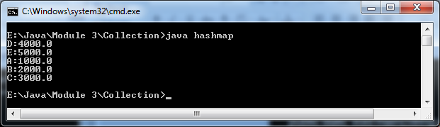
import java.util.*;
class hashmap
{
public static void main(String args[])
{
HashMap hm=new HashMap();
hm.put("A",new Double(1000));
hm.put("B",new Double(2000));
hm.put("C",new Double(3000));
hm.put("D",new Double(4000));
hm.put("E",new Double(5000));
Set s=hm.entrySet();
Iterator i=s.iterator();
while(i.hasNext())
{
Map.Entry me=(Map.Entry)i.next();
System.out.print(me.getKey()+ ":");
System.out.println(me.getValue());
}
}
}

Slide 61
TreeMap
Implements Map
Storing key/value pair in sorted order
TreeMap()
TreeMap(Comparator c)
TreeMap(Map m)
TreeMap(SortedMap sm)

Slide 62
import java.util.*;
class treemap
{
public static void main(String args[])
{
TreeMap tm=new TreeMap();
tm.put("A",new Double(1000));
tm.put("B",new Double(2000));
tm.put("C",new Double(3000));
tm.put("D",new Double(4000));
tm.put("E",new Double(5000));
Set s=tm.entrySet();
Iterator i=s.iterator();
while(i.hasNext())
{
Map.Entry me=(Map.Entry)i.next();
System.out.print(me.getKey()+ ":");
System.out.println(me.getValue());
}
}
}

Slide 63
LinkedHashMap
Extends HashMap
Maintains a linkedlist of entries in the map in the order in which they are entered
LinkedHashMap()
LinkedHashMap(Map m)
LinkedHashMap(int cap)
LinkedHashMap(int cap, float fillratio)
LinkedHashMap(int cap, float fillratio, boolean order)

Slide 64
Comparator
To sort elements in collection and maps
Eg:- TreeSet and TreeMap
Specify a Comparator object when creating a set or map
int compare(Object obj1, Object obj2)
0 (obj1 = obj2)
+ve (obj1 > obj2)
-ve (obj1 < obj2)
boolean equals(Object obj)

Slide 65
import java.util.*;
class MyComp implements Comparator
{
public int compare(Object a, Object b)
{
String aStr, bStr;
aStr = (String) a;
bStr = (String) b;
// reverse the comparison
return bStr.compareTo(aStr);
}
// no need to override equals
}
class CompDemo
{
public static void main(String args[])
{
TreeSet ts = new TreeSet(new MyComp());
ts.add("C");
ts.add("A");
ts.add("B");
ts.add("E");
ts.add("F");
ts.add("D");
Iterator i = ts.iterator();
while(i.hasNext())
{
Object element = i.next();
System.out.print(element + " ");
}
System.out.println();
}
}
OUTPUT :- Tree is now stored in reverse order:
F E D C B A

Slide 66
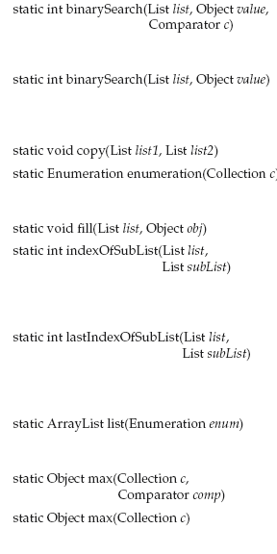
The Collection Algorithms
Predefined algorithms that can be used with collections and maps
Defined as static methods in Collections class
Continuation at page 478 & 479

Slide 67
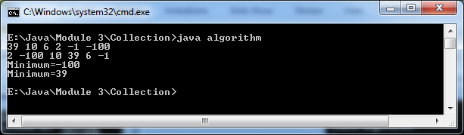
import java.util.*;
class algorithm
{
public static void main(String args[])
{
LinkedList ll=new LinkedList();
ll.add(new Integer(10));
ll.add(new Integer(6));
ll.add(new Integer(-1));
ll.add(new Integer(2));
ll.add(new Integer(39));
ll.add(new Integer(-100));
Comparator r=Collections.reverseOrder();
Collections.sort(ll,r);
Iterator itr=ll.iterator();
while(itr.hasNext())
{
Object element=itr.next();
System.out.print(element +" ");
}
System.out.println();
Collections.shuffle(ll);
itr=ll.iterator();
while(itr.hasNext())
{
Object element=itr.next();
System.out.print(element +" ");
}
System.out.println();
System.out.println("Minimum="+Collections.min(ll));
System.out.println("Minimum="+Collections.max(ll));
}
}

Slide 68
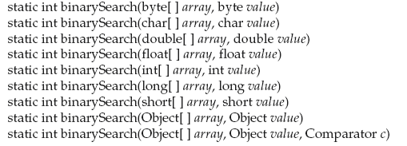
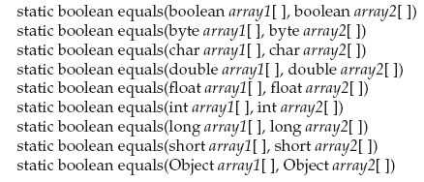
Arrays class

Slide 69
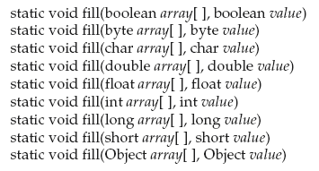
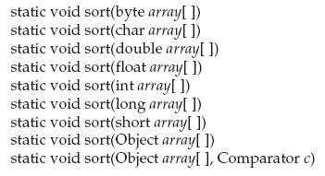

Slide 70
Syllabus
I/O Basics
  Byte Streams and Character Streams
  Reading Console Input
Collections Framework
Applets & Applet Architecture
  Applet Skelton
  Passing Parameters to Applet
Event Handling
  Event Model
  Event Classes
  Event Listener Interfaces
AWT
  AWT Classes
  AWT Controls
  Layout Managers and Menus.
Swing
  JApplet
  Jbuttons
  JTables

Slide 71
Applets
Applets are small applications that are accessed on an Internet server, transported over the Internet, automatically installed, and run as part of a Web document.
Applets can be divided in to:
  Local Applets :
    These are developed locally and stored in a local system.
    When a web page is trying to find a local applet, it simply searches the directories in the local system and locates and load the specified applet.
  Remote Applets :
    These are developed by someone else and stored in a remote computer connected to the internet.
    In order to locate and load the remote applet, we must know the applets address (Uniform Resource Locator (URL)) on the web. This address must be specified in the applet’s HTML document as the value of the CODEBASE attribute.

Slide 72
Application Program Vs Applet Program
Applet does not use main() method for initiating the execution of a code. Applet, when loaded, automatically call certain methods of Applet class to start and execute the applet code.
Applets cannot run independently. They are run from inside a web page using a special feature known as HTML tag.
Applets cannot read from or write into a file in the local system.
Applets cannot communicate with each other server on the network.
Applets cannot run any program from the local system.
Applets are restricted from using libraries from other languages such as C or C++.
These restrictions ensure that an applet cannot do any damage
to the local system.

Slide 73
Applets : Example
Abstract Window Toolkit, for GUI
import java.awt.*; import java.applet.*; public class SimpleApplet extends Applet { public void paint(Graphics g) { g.drawString("A Simple Applet", 20, 20); } }
applet , for Applet class
Always (public and extends Applet)
Called to redraw applet
Over ridden method[class Applet]

Slide 74
Applets
There are two ways in which you can run an applet:
  Executing the applet within a Java-compatible Web browser :
    Write a short HTML text file that contains the appropriate APPLET tag
    Example:
        <applet code="SimpleApplet" width=200 height=60>
        </applet>
    The width and height statements specify the dimensions of the display area used by the applet.
    The preceding HTML file is called RunApp.html.
    Execute the browser and then load this file, which causes SimpleApplet to be executed.
  Using an applet viewer(appletviewer) :
    C:\>appletviewer RunApp.html
    An applet viewer executes your applet in a window.

Slide 75
Applets
Another way is simply include a comment at the head of the Java source code file that contains the APPLET tag.
Do the following three steps:
  Edit a Java source file.
  Compile the program.
  Execute the applet viewer, specifying the name of your applet’s source file. The applet viewer will encounter the APPLET tag within the comment and execute the applet.

Slide 76
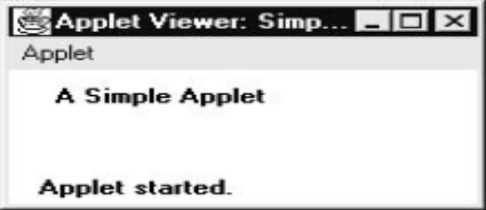
Applets
import java.awt.*; import java.applet.*; /* <applet code="SimpleApplet" width=200 height=60> </applet> */ public class SimpleApplet extends Applet { public void paint(Graphics g) { g.drawString("A Simple Applet", 20, 20); } }
Source code is documented
with prototype of HTML statements
Output
Save file as SimpleApplet.java
Compile SimpleApplet.java
Execute appletviewer SimpleApplet.java

Slide 77
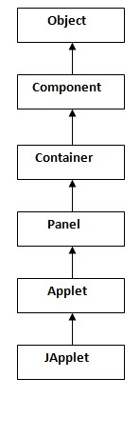
Applet Class
Applet class provides all necessary support for applet execution, such as starting, stopping, load and display images, load and play audio clips etc.
Applet provides all of the necessary support for window-based activities.

Slide 78
Applet Architecture
An applet is a window-based program.
Applets are event driven. An applet waits until an event occurs.
The user interacts with the applet when he or she wants.
The AWT notifies the applet about an event by calling an event handler that has been provided by the applet.
The applet must take appropriate action and then quickly return control to the AWT.
Example :
  If the user clicks a mouse inside the applet’s window, a mouse-clicked event is generated
  If the user presses a key while the applet’s window has input focus, a keypress event is generated.

Slide 79
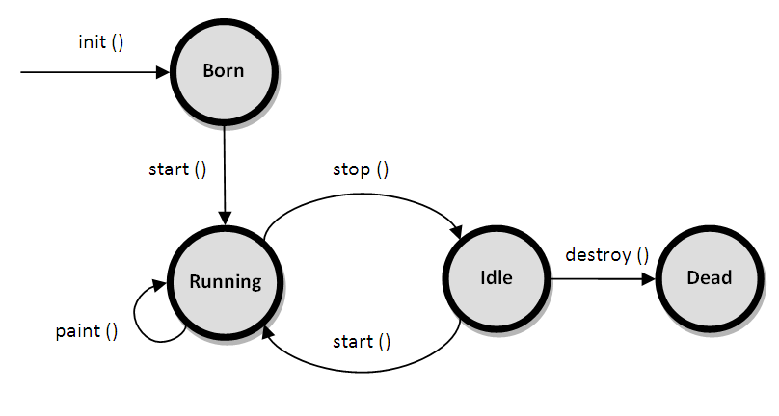
Applet Life Cycle

Slide 80
Applet Life Cycle
Born on initialization state :
  Applet enters the initialization state when it is first loaded.
  This is achieved by calling init()
  This occurs only once in the applet’s life cycle
  At this stage, we may do the following
    Create objects needed by the applet
    Initialize variables
    Load images or fonts
    Setup colors

Slide 81
Applet Life Cycle
Running state :
  Applet enters this state when the system calls the start() method
  This occrs automatically after the applet is initialized(init())
  Starting can also occur if the applet is already in stopped(Idle) state.
  start() can call more than once.
  start( ) is called each time an applet’s HTML document is displayed onscreen. So, if a user leaves a web page and comes back, the applet resumes execution at start( ).

Slide 82
Applet Life Cycle
Idle state or Stopped state :
  An applet becomes idle when it is stopped from running. We can do so by calling stop() explicitly
  Stopping occurs automatically when we leave the page containing the currently running applet
    Example : when it goes to another page
  If the user returns to the page, we can restart them by calling start( ).
Dead or distroyed state :
  An applet is said to be dead when it is removed from memory
  This occurs automatically by invoking distroy().
  At this point, we should free up any resources the applet may be using. The stop( ) method is always called before destroy( ).
  This occrs only once in the applet life cycle

Slide 83
Applet Life Cycle
Display state:
  Applet moves to the this state whenever it has to perform some output operations on the screen
  This happens immediately after the applet enters into the running state
  paint() is called to accomplish this task
  The paint( ) method is called each time our applet’s output must be redrawn
  This situation can occur for several reasons. For example,
    the window in which the applet is running may be overwritten by another window and then uncovered
    the applet window may be minimized and then restored.
  The paint( ) method has one parameter of type Graphics. This parameter describes the graphics environment in which the applet is running.

Slide 84
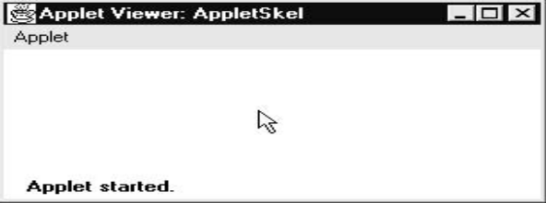
Applet Skeleton
// Called when the applet is stopped. public void stop() { // suspends execution } /* Called when applet is terminated. This is the last method executed. */ public void destroy() { // perform shutdown activities } /* Called when an applet's window must be restored. */ public void paint(Graphics g) { // redisplay contents of window } }
import java.awt.*; import java.applet.*; /* <applet code="AppletSkel" width=300 height=100> </applet> */ public class AppletSkel extends Applet { public void init() // Called first. { // initialization } /* Called second, after init(). Also called whenever the applet is restarted. */ public void start() { // start or resume execution }
Output

Slide 85
Applet Skeleton
Applets override a set of methods
  init(), start(), stop(), and destroy() : These are defined by Applet
  paint() : It is defined by the AWT Component class
When an applet begins, the AWT calls the following methods, in this sequence:
  init( )
  start( )
  paint( )
When an applet is terminated, the following sequence of method calls takes place:
  stop( )
  destroy( )

Slide 86
Applet Display Methods
To output a string to an applet :
  drawString( ), which is a member of the Graphics class
General form: void drawString(String message, int x, int y)
message is the string to be output beginning at x,y. In a Java window, the upper-left corner is location 0,0.

Slide 87
Applet Display Methods
To set the background color of an applet’s window, use setBackground( ).
To set the foreground color, use setForeground( ).
General forms: void setBackground(Color newColor)
void setForeground(Color newColor)
newColor specifies the new color
The class Color defines the constants to specify colors:
Color.black Color.magenta Color.blue Color.orange
Color.cyan Color.pink Color.darkGray Color.red
Color.gray Color.white Color.green Color.yellow
Color.lightGray
The default foreground color is black. The default background color is light gray.

Slide 88
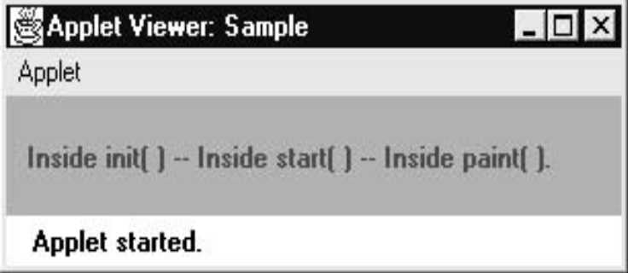
import java.awt.*; import java.applet.*; /* <applet code="Sample" width=300 height=50> </applet> */ public class Sample extends Applet { String msg; public void init() { setBackground(Color.cyan); setForeground(Color.red); msg = "Inside init( ) --"; } public void start() { msg += " Inside start( ) --"; } public void paint(Graphics g) { msg += " Inside paint( )."; g.drawString(msg, 10, 30); } }
Output

Slide 89
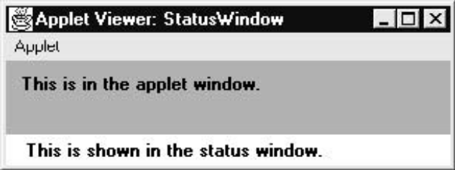
Status Window
import java.awt.*; import java.applet.*; /* <applet code="StatusWindow" width=300 height=50> </applet> */ public class StatusWindow extends Applet { public void init() { setBackground(Color.cyan); } public void paint(Graphics g) { g.drawString("This is in the applet window.", 10, 20); showStatus("This is shown in the status window."); } }
Output

Slide 90
HTML APPLET TAG
< APPLET [CODEBASE = codebaseURL] CODE = appletFile [ALT = alternateText] [NAME = appletInstanceName] WIDTH = pixels HEIGHT = pixels [ALIGN = alignment] [VSPACE = pixels] [HSPACE = pixels] > [< PARAM NAME = AttributeName VALUE = AttributeValue>] [< PARAM NAME = AttributeName2 VALUE = AttributeValue>] . . . [HTML Displayed in the absence of Java] </APPLET>

Slide 91
HTML APPLET TAG
CODEBASE : base URL of the applet code
CODE : applet name
ALT : alternative short text message that should be displayed if the browser understands the APPLET tag but can’t currently run Java applets.
NAME : specify the name for the applet instance.
WIDTH and HEIGHT : size (in pixels) of the applet display area.
ALIGN : specifies the alignment of the applet: LEFT, RIGHT, TOP, BOTTOM, MIDDLE, BASELINE, TEXTTOP, ABSMIDDLE, and ABSBOTTOM.
VSPACE : specifies the space, in pixels, above and below the applet.
HSPACE : specifies the space, in pixels, on each side of the applet.
PARAM NAME and VALUE allows us to specify applet specific arguments in an HTML page. Applets access their attributes with the getParameter( ) method

Slide 92
Passing Parameters to Applet
The APPLET tag in HTML allows us to pass parameters to our applet.
To retrieve a parameter, use the getParameter( ) method.
It returns the value of the specified parameter in the form of a String object.
If a parameter isn’t available, getParameter( ) will return null.
Also, conversions to numeric types may cause NumberFormatException.

Slide 93
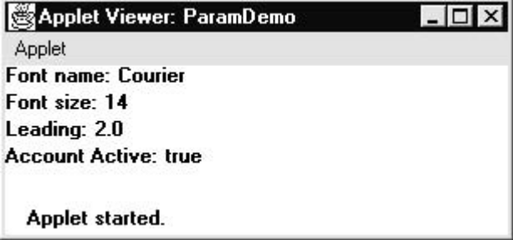
import java.awt.*; import java.applet.*; /* <applet code="ParamDemo" width=300 height=80> <param name=fontName value=Courier> <param name=fontSize value=14> <param name=leading value=2> <param name=accountEnabled value=true> </applet> */ public class ParamDemo extends Applet { String fontName; int fontSize; float leading; boolean active; public void start() { String param; fontName = getParameter("fontName"); if(fontName == null) fontName = "Not Found"; param = getParameter("fontSize"); try { if(param != null) // if not found fontSize = Integer.parseInt(param); else fontSize = 0; }
catch(NumberFormatException e) { fontSize = -1; } param = getParameter("leading"); try { if(param != null) // if not found leading = Float.valueOf(param).floatValue(); else leading = 0; } catch(NumberFormatException e) { leading = -1; } param = getParameter("accountEnabled"); if(param != null) active = Boolean.valueOf(param).booleanValue(); } public void paint(Graphics g) {g.drawString("Font name: " + fontName, 0, 10); g.drawString("Font size: " + fontSize, 0, 26); g.drawString("Leading: " + leading, 0, 42); g.drawString("Account Active: " + active, 0, 58); } }

Slide 94
Passing Parameters to Applet
String to integer conversion :
int i = Integer.parseInt(str);
String to float conversion :
float f = Float.valueOf(str).floatValue();
String to boolean conversion :
boolean b = Boolean.valueOf(str).booleanValue();

Slide 95
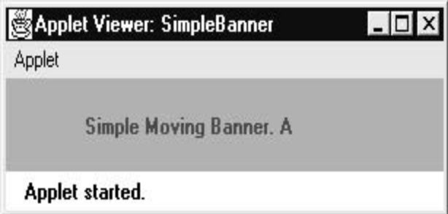
// Moving Banner import java.awt.*; import java.applet.*; /* <applet code="SimpleBanner" width=300 height=50> </applet> */ public class SimpleBanner extends Applet implements Runnable { String msg = " A Simple Moving Banner."; Thread t = null; int state; boolean stopFlag; public void init() { setBackground(Color.cyan); setForeground(Color.red); } public void start() { t = new Thread(this); stopFlag = false; t.start(); } public void run() { char ch; for( ; ; ) {
try {repaint(); Thread.sleep(250); ch = msg.charAt(0); msg = msg.substring(1, msg.length()); msg += ch; if(stopFlag) break; } catch(InterruptedException e) {} } } public void stop() { stopFlag = true; t = null; } public void paint(Graphics g) { g.drawString(msg, 50, 30); } }

Slide 96
// A parameterized banner import java.awt.*; import java.applet.*; /* <applet code="ParamBanner" width=300 height=50> <param name=message value="Java makes the Web move!"> </applet> */ public class ParamBanner extends Applet implements Runnable { String msg; Thread t = null; int state; boolean stopFlag; public void init() { setBackground(Color.cyan); setForeground(Color.red); } public void start() { msg = getParameter("message"); if(msg == null) msg = "Message not found."; msg = " " + msg; t = new Thread(this); stopFlag = false; t.start(); } public void run() { char ch; for( ; ; ) {
try { repaint(); Thread.sleep(250); ch = msg.charAt(0); msg = msg.substring(1, msg.length()); msg += ch; if(stopFlag) break; } catch(InterruptedException e) {} } } public void stop() { stopFlag = true; t = null; } public void paint(Graphics g) { g.drawString(msg, 50, 30); } }

Slide 97
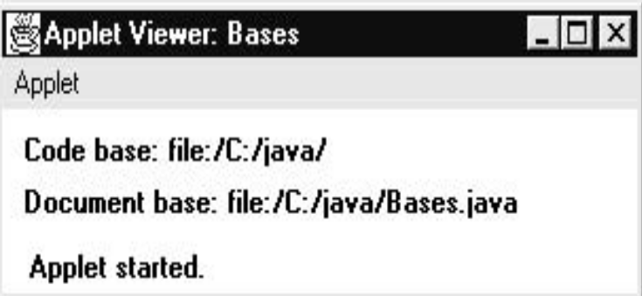
import java.awt.*; import java.applet.*; import java.net.*; /* <applet code="Bases" width=300 height=50> </applet> */ public class Bases extends Applet { public void paint(Graphics g) { String msg; URL url = getCodeBase(); // get code base msg = "Code base: " + url.toString(); g.drawString(msg, 10, 20); url = getDocumentBase(); // get document base msg = "Document base: " + url.toString(); g.drawString(msg, 10, 40); } }

Slide 98
Syllabus
I/O Basics
  Byte Streams and Character Streams
  Reading Console Input
Collections Framework
Applets & Applet Architecture
  Applet Skelton
  Passing Parameters to Applet
Event Handling
  Event Model
  Event Classes
  Event Listener Interfaces
AWT
  AWT Classes
  AWT Controls
  Layout Managers and Menus.
Swing
  JApplet
  Jbuttons
  JTables

Slide 99
Event Handling
Applets are event-driven programs.
Examples of events :
  Pressing a button
  Enter a character using keyboard
  Mouse clicks
Events are supported by the java.awt.event package

Slide 100
Event Model : Delegation Event Model
Its concept is :
  A source generates an event and sends it to one or more listeners.
  The listener simply waits until it receives an event.
  Once received, the listener processes the event and then returns.
The listeners must register with a source in order to receive an event notification.
Advantage :
  Notifications are sent only to listeners that want to receive them.
  Previously, an event was propagated up the containment hierarchy until it was handled by a component. This required components to receive events that they did not process, and it wasted valuable time. The delegation event model eliminates this overhead

Slide 101
Event Model : Event
An event is an object that describes a state change in a source.
It can be generated by
  Personal interacting
    Example : Pressing a button, entering a character via the keyboard, selecting an item in a list, and clicking the mouse etc.
  Not directly caused by personal interactions
    Example : An event may be generated when a timer expires, a counter exceeds a value, a software or hardware failure occurs, an operation is completed etc.

Slide 102
Event Model : Event Sources
A source is an object that generates an event.
A source must register listeners in order for the listeners to receive notifications about a specific type of event.
General form: public void addTypeListener(TypeListener el)
  Type - event name
  el - reference to the event listener.
Example :
addKeyListener() :The method that registers a keyboard event listener
addMouseMotionListener() :The method that registers a mouse motion listener

Slide 103
Event Model : Event Sources
Sources may generate more than one type of event.
Multicasting: When an event occurs, all registered listeners are notified and receive a copy of the event object. The notifications are sent only to listeners that register to receive them.
Unicasting: Some sources may allow only one listener to register.
General form :
public void addTypeListener(TypeListener el)
throws java.util.TooManyListenersException

Slide 104
Event Model : Event Sources
Unregister a specific type of event
  General form :
  public void removeTypeListener(TypeListener el)
  Type - event name
  el - reference to the event listener.
  Example :
  removeKeyListener( ) :To remove a keyboard listener

Slide 105
Event Model : Event Listener
A listener is an object that is notified when an event occurs.
It has two major requirements.
  It must have been registered with one or more sources to receive notifications about specific types of events.
  It must implement methods to receive and process these notifications. These methods are defined in a set of interfaces found in java.awt.event.
    Example: MouseMotionListener interface defines two methods to receive notifications when the mouse is dragged or moved. Any object may receive and process one or both of these events if it provides an implementation of this interface.

Slide 106
Event Class
EventObject
    superclass for all events
    defined inside java.util package
    constructor : EventObject(Object src)
  src - event object
    two methods:
      Object getSource( ): returns the event source
      toString( ) : returns the string equivalent of the event
AWTEvent
    superclass of all AWT-based events
    defined within the java.awt package
    subclass of EventObject.
    int getID( ) - determine the event type

Slide 107
Main Event Classes in java.awt.event
Event Class | Description
ActionEvent | Generated when a button is pressed, a list item is double-clicked, or a menu item is selected.
AdjustmentEvent | Generated when a scroll bar is manipulated.
ComponentEvent | Generated when a component is hidden, moved, resized, or becomes visible.
ContainerEvent | Generated when a component is added to or removed from a container.
FocusEvent | Generated when a component gains or loses keyboard focus.
InputEvent | Abstract super class for all component input event classes.
ItemEvent | Generated when a check box or list item is clicked; also occurs when a choice selection is made or a checkable menu item is selected or deselected.
KeyEvent | Generated when input is received from the keyboard.
MouseEvent | Generated when the mouse is dragged, moved, clicked, pressed, or released; also generated when the mouse enters or exits a component.
MouseWheelEvent | Generated when the mouse wheel is moved.
TextEvent | Generated when the value of a text area or text field is changed.
WindowEvent | Generated when a window is activated, closed, deactivated, deiconified, iconified, opened, or quit.

Slide 108
Event Class: ActionEvent Class
ActionEvent is generated when
  a button is pressed
  a list item is double-clicked, or
  a menu item is selected.
ActionEvent class defines some set of integer:
  ALT_MASK, CTRL_MASK, META_MASK, and SHIFT_MASK
    used to identify any modifiers associated with an action event
  ACTION_PERFORMED : used to identify action events

Slide 109
Event Class: ActionEvent Class
constructors:
    ActionEvent(Object src, int type, String cmd)
    ActionEvent(Object src, int type, String cmd, int modifiers)
    ActionEvent(Object src, int type, String cmd, long when, int modifiers)
  src –object of event source
  type – event type
  cmd -command string [button press, cmd is the label on the button]
  modifiers – which modifier keys (ALT, CTRL, META, and/or SHIFT) were pressed when the event was generated.
  when - when the event occurred.

Slide 110
Event Class: ActionEvent Class
String getActionCommand( ) : obtain the command name
int getModifiers( ) : returns a value that indicates which modifier keys (ALT, CTRL, META, and/or SHIFT) were pressed when the event was generated
long getWhen( ) : returns the time at which the event took place

Slide 111
Event Class: AdjustmentEvent Class
An AdjustmentEvent is generated by a scroll bar.
AdjustmentEvent class integer constants
Integer constants to identify adjustment events | meanings
BLOCK_DECREMENT | The user clicked inside the scroll bar to decrease its value.
BLOCK_INCREMENT | The user clicked inside the scroll bar to increase its value.
TRACK | The slider was dragged.
UNIT_DECREMENT | The button at the end of the scroll bar was clicked to decrease its value.
UNIT_INCREMENT | The button at the end of the scroll bar was clicked to increase its value.
ADJUSTMENT_VALUE_CHANGED | Whether a change has occurred

Slide 112
Event Class: AdjustmentEvent Class
Constructor:
AdjustmentEvent(Adjustable src, int id, int type, int data)
  src - object of event source
  id - ADJUSTMENT_VALUE_CHANGED.
  type - event type
  data - associated data
Adjustable getAdjustable( ) :returns the object that generated the event
int getAdjustmentType( ) : returns one of the constants defined by AdjustmentEvent
int getValue( ) : returns the amount of the adjustment can be obtained

Slide 113
Event Class: ComponentEvent Class
A ComponentEvent is generated when the size, position, or visibility of a component is changed.
ComponentEvent class Integer constants
Integer constants to identify adjustment events | meanings
COMPONENT_HIDDEN | The component was hidden.
COMPONENT_MOVED | The component was moved.
COMPONENT_RESIZED | The component was resized.
COMPONENT_SHOWN | The component became visible.

Slide 114
Event Class: ComponentEvent Class
Constructor:
ComponentEvent(Component src, int type)
  src - object of event source
type - event type
Component getComponent( ):returns the component that generated the event

Slide 115
Event Class: ContainerEvent Class
A ContainerEvent is generated when a component is added to or removed from a container
Two types of container events.
  COMPONENT_ADDED : A component has been added to the container
  COMPONENT_REMOVED : A component has been removed from the container.
Constructor:
ContainerEvent(Component src, int type, Component comp)
  src - object of event source
type - event type
comp - component that has been added to or removed from the container

Slide 116
Event Class: ContainerEvent Class
Container getContainer( ) : Obtain a reference to the container that generated this event
Component getChild( ) : returns a reference to the component that was added to or removed from the container

Slide 117
Event Class: FocusEvent Class
A FocusEvent is generated when a component gains or loses input focus.
Two integer constants: FOCUS_GAINED and FOCUS_LOST.
Constructors:
  FocusEvent(Component src, int type)
  FocusEvent(Component src, int type, boolean temporaryFlag)
  Focus Event(Component src, int type, boolean temporaryFlag,
  Component other)
  src - object of event source
type - event type
temporaryFlag - Set to true if the focus event is temporary. Otherwise, it is set to false.
other - If a FOCUS_GAINED event occurred, other will refer to the component that lost focus. Conversely, if a FOCUS_LOST event occurred, other will refer to the component that gains focus.

Slide 118
Event Class: FocusEvent Class
Component getOppositeComponent( ): The opposite component is returned.
boolean isTemporary( ): The method returns true if the focus change is temporary. Otherwise, it returns false

Slide 119
Event Class: InputEvent Class
Subclass of ComponentEvent
Its subclasses are KeyEvent and MouseEvent.
Abstract superclass for all component input event class

Slide 120
Event Class: ItemEvent Class
Generated when a check box or a list item is clicked or when a checkable menu item is selected or deselected.
Two types of item events :
  DESELECTED :The user deselected an item
  SELECTED :The user selected an item
Defines one integer constant:
  ITEM_STATE_CHANGED: whether the state change or not
Constructor:
ItemEvent(ItemSelectable src, int type, Object entry, int state)
  src - object of event source
type - event type
entry -The specific item that generated the item event
state - The current state of that item

Slide 121
Event Class: ItemEvent Class
Object getItem( ) : to obtain a reference to the item that generated an event
int getStateChange( ) : returns the state change (i.e., SELECTED or DESELECTED) for the event

Slide 122
Event Class: KeyEvent Class
Subclass of InputEvent.
Generated when keyboard input occurs.
Three types of key events:
  KEY_PRESSED : generated when any key is pressed
  KEY_RELEASED : generated when any key is released
  KEY_TYPED: when a character is generated
char getKeyChar( ) : returns the character that was entered. If no valid character is available, then getKeyChar( ) returns CHAR_UNDEFINED.

Slide 123
Event Class: KeyEvent Class
Constructors:
KeyEvent(Component src, int type, long when, int modifiers, int code)
KeyEvent(Component src, int type, long when, int modifiers, int code, char ch)
  src - object of event source
type - event type
when - The system time at which the key was pressed
modifiers - which modifiers were pressed when this key event occurred.
code - The virtual key code
ch - The character equivalent
If no valid character exists, then ch contains CHAR_UNDEFINED.
For KEY_TYPED events, code will contain VK_UNDEFINED.

Slide 124
Event Class: MouseEvent Class
MouseEvent is a subclass of InputEvent.
Eight mouse events:
  MOUSE_CLICKED: The user clicked the mouse.
  MOUSE_DRAGGED: The user dragged the mouse.
  MOUSE_ENTERED: The mouse entered a component.
  MOUSE_EXITED: The mouse exited from a component.
  MOUSE_MOVED: The mouse moved.
  MOUSE_PRESSED: The mouse was pressed.
  MOUSE_RELEASED: The mouse was released.
  MOUSE_WHEEL: The mouse wheel was moved

Slide 125
Event Class: MouseEvent Class
Constructor:
MouseEvent(Component src, int type, long when, int modifiers, int x, int y, int clicks, boolean triggersPopup)
  src - object of event source
type - event type
when - The system time at which the mouse event occurred
modifiers - which modifiers were pressed
x and y - The coordinates of the mouse are passed in.
clicks - The click count
triggersPopup - if this event causes a pop-up menu

Slide 126
Event Class: MouseEvent Class
Methods :
  int getX( ): return the X coordinates of the mouse when the event occurred
  int getY( ): return the Y coordinates of the mouse when the event occurred
  Point getPoint( ): to obtain the coordinates of the mouse.
  translatePoint(int x, int y ): changes the location of the event.
  int getClickCount( ): obtains the number of mouse clicks for this event.
  boolean isPopupTrigger( ): tests if this event causes a pop-up menu to appear on this platform.

Slide 127
Event Class: MouseWeelEvent Class
Subclass of MouseEvent.
Defines two integer constants:
  WHEEL_BLOCK_SCROLL: A page-up or page-down scroll event occurred.
  WHEEL_UNIT_SCROLL: A line-up or line-down scroll event occurred.

Slide 128
Event Class: MouseWeelEvent Class
Constructor:
MouseWheelEvent(Component src, int type, long when, int modifiers, int x, int y, int clicks, boolean triggersPopup, int scrollHow, int amount, int count)
  src - object of event source
type - event type
when - The system time at which the mouse event occurred
modifiers - which modifiers were pressed
x and y - The coordinates of the mouse are passed in.
clicks - The click count
triggersPopup - if this event causes a pop-up menu
scrollHow-WHEEL_UNIT_SCROLL or WHEEL_BLOCK_SCROLL.
amount - The number of units to scroll
count - number of rotational units that the wheel moved.

Slide 129
Event Class: MouseWeelEvent Class
int getWheelRotation( ): To obtain the number of rotational units. If the value is positive, the wheel moved counterclockwise. If the value is negative, the wheel moved clockwise.
int getScrollType( ) : To obtain the type of scroll. (WHEEL_UNIT_SCROLL or WHEEL_BLOCK_SCROLL)
int getScrollAmount( ): If the scroll type is WHEEL_UNIT_SCROLL, we can obtain the number of units to scroll

Slide 130
Event Class: TextWeelEvent Class
Generated by text fields and text areas when characters are entered by a user or program.
TextEvent defines the integer constant TEXT_VALUE_CHANGED.
Constructor :
TextEvent(Object src, int type)
  src - object of event source
type - event type

Slide 131
Event Class: WindowEvent Class
Subclass of ComponentEvent.
Ten types of window events :
  WINDOW_ACTIVATED: The window was activated.
  WINDOW_CLOSED: The window has been closed.
  WINDOW_CLOSING: The user requested that the window be closed.
  WINDOW_DEACTIVATED: The window was deactivated.
  WINDOW_DEICONIFIED: The window was deiconified.
  WINDOW_GAINED_FOCUS: The window gained input focus.
  WINDOW_ICONIFIED: The window was iconified.
  WINDOW_LOST_FOCUS: The window lost input focus.
  WINDOW_OPENED: The window was opened.
  WINDOW_STATE_CHANGED: The state of the window changed.

Slide 132
Event Class: WindowEvent Class
Constructors are :
WindowEvent(Window src, int type)
WindowEvent(Window src, int type, Window other)
WindowEvent(Window src, int type, int fromState, int toState)
WindowEvent(Window src, int type, Window other, int fromState, int toState)
  src - object of event source
type - event type
other - specifies the opposite window
fromState - specifies the prior state of the window
toState - specifies the new state of the window

Slide 133
Event Class: WindowEvent Class
Window getWindow( ): It returns the Window object that generated the event.
Window getOppositeWindow():return the opposite window
int getOldState():the previous window state
int getNewState():the current window state

Slide 134
Event Listener Interface
Commonly Used Event Listener Interfaces
Interface | Description
ActionListener | Defines one method to receive action events.
AdjustmentListener | Defines one method to receive adjustment events.
ComponentListener | Defines four methods to recognize when a component is hidden, moved, resized, or shown.
ContainerListener | Defines two methods to recognize when a component is added to or removed from a container.
FocusListener | Defines two methods to recognize when a component gains or loses keyboard focus.
ItemListener | Defines one method to recognize when the state of an item changes.
KeyListener | Defines three methods to recognize when a key is pressed, released, or typed.
MouseListener | Defines five methods to recognize when the mouse is clicked, enters a component, exits a component, is pressed, or is released.
MouseMotionListener | Defines two methods to recognize when the mouse is dragged or moved.
MouseWheelListener | Defines one method to recognize when the mouse wheel is moved.
TextListener | Defines one method to recognize when a text value changes.
WindowFocusListener | Defines two methods to recognize when a window gains or loses input focus.
WindowListener | Defines seven methods to recognize when a window is activated, closed, deactivated, deiconified, iconified, opened, or quit.

Slide 135
Event Listener Interface
The ActionListener Interface
  void actionPerformed(ActionEvent ae)
The AdjustmentListener Interface
void adjustmentValueChanged(AdjustmentEvent ae)
The ComponentListener Interface
void componentResized(ComponentEvent ce)
void componentMoved(ComponentEvent ce)
void componentShown(ComponentEvent ce)
void componentHidden(ComponentEvent ce)

Slide 136
Event Listener Interface
The ContainerListener Interface
void componentAdded(ContainerEvent ce)
void componentRemoved(ContainerEvent ce)
The FocusListener Interface
void focusGained(FocusEvent fe)
void focusLost(FocusEvent fe)
The ItemListener Interface
void itemStateChanged(ItemEvent ie)
The KeyListener Interface
void keyPressed(KeyEvent ke)
void keyReleased(KeyEvent ke)
void keyTyped(KeyEvent ke)

Slide 137
Event Listener Interface
The MouseListener Interface
void mouseClicked(MouseEvent me)
void mouseEntered(MouseEvent me)
void mouseExited(MouseEvent me)
void mousePressed(MouseEvent me)
void mouseReleased(MouseEvent me)
The MouseMotionListener Interface
void mouseDragged(MouseEvent me)
void mouseMoved(MouseEvent me)
The MouseWheelListener Interface
void mouseWheelMoved(MouseWheelEvent mwe)

Slide 138
Event Listener Interface
The TextListener Interface
void textChanged(TextEvent te)
The WindowFocusListener Interface
void windowGainedFocus(WindowEvent we)
void windowLostFocus(WindowEvent we)
The WindowListener Interface
  void windowActivated(WindowEvent we)
  void windowClosed(WindowEvent we)
  void windowClosing(WindowEvent we)
  void windowDeactivated(WindowEvent we)
  void windowDeiconified(WindowEvent we)
  void windowIconified(WindowEvent we)
  void windowOpened(WindowEvent we)

Slide 139
//Handling Mouse Events import java.awt.*; import java.awt.event.*; import java.applet.*; /* <applet code="MouseEvents" width=300 height=100> </applet> */ public class MouseEvents extends Applet implements MouseListener, MouseMotionListener { String msg = ""; int mouseX = 0, mouseY = 0; public void init() { addMouseListener(this); addMouseMotionListener(this); } public void mouseClicked(MouseEvent me) { mouseX = 0; mouseY = 10; msg = "Mouse clicked."; repaint(); }
public void mouseEntered(MouseEvent me) { mouseX = 0; mouseY = 10; msg = "Mouse entered."; repaint(); } public void mouseExited(MouseEvent me) { mouseX = 0; mouseY = 10; msg = "Mouse exited."; repaint(); } public void mousePressed(MouseEvent me) { mouseX = me.getX(); mouseY = me.getY(); msg = "Down"; repaint(); } public void mouseReleased(MouseEvent me) { mouseY = me.getY(); msg = "Up"; repaint(); }

Slide 140
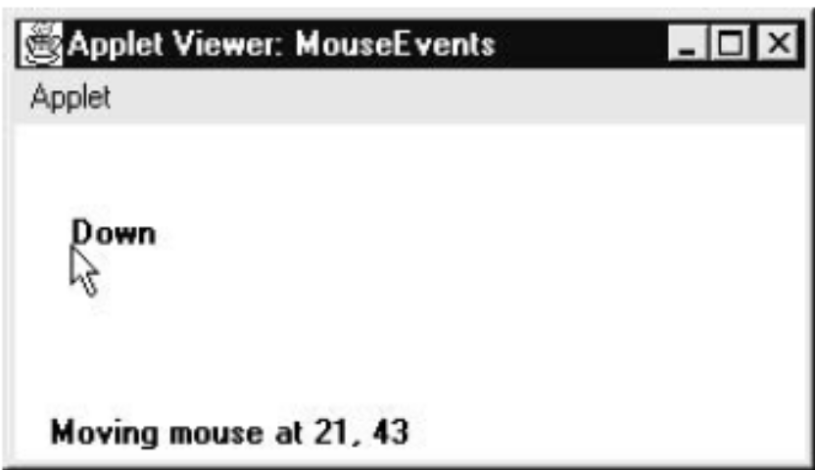
public void mouseDragged(MouseEvent me) { mouseX = me.getX(); mouseY = me.getY(); msg = "*"; showStatus("Dragging mouse at " + mouseX + ", " + mouseY); repaint(); } public void mouseMoved(MouseEvent me) { showStatus("Moving mouse at " + me.getX() + ", " + me.getY()); } public void paint(Graphics g) { g.drawString(msg, mouseX, mouseY); } }

Slide 141
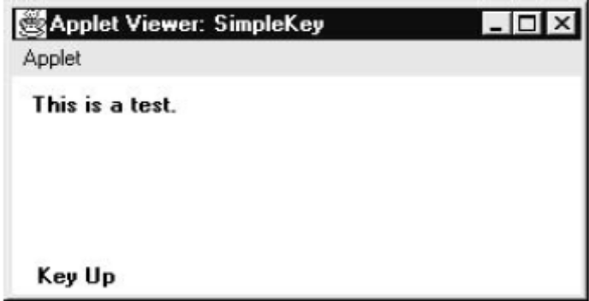
//Handling Keyboard Events import java.awt.*; import java.awt.event.*; import java.applet.*; /* <applet code="SimpleKey" width=300 height=100> </applet> */ public class SimpleKey extends Applet implements KeyListener { String msg = ""; int X = 10, Y = 20; // output coordinates public void init() { addKeyListener(this); requestFocus(); // request input focus } public void keyPressed(KeyEvent ke) { showStatus("Key Down"); }
public void keyReleased(KeyEvent ke) { showStatus("Key Up"); } public void keyTyped(KeyEvent ke) { msg += ke.getKeyChar(); repaint(); } public void paint(Graphics g) { g.drawString(msg, X, Y); } }

Slide 142
//Handling Keyboard Events import java.awt.*; import java.awt.event.*; import java.applet.*; /* <applet code="KeyEvents" width=300 height=100> </applet> */ public class KeyEvents extends Applet implements KeyListener { String msg = ""; int X = 10, Y = 20; // output coordinates public void init() { addKeyListener(this); requestFocus(); // request input focus } public void keyPressed(KeyEvent ke) { showStatus("Key Down"); int key = ke.getKeyCode();
switch(key) { case KeyEvent.VK_F1:msg += "<F1>"; break; case KeyEvent.VK_F2: msg += "<F2>"; break; case KeyEvent.VK_F3: msg += "<F3>"; break; case KeyEvent.VK_PAGE_DOWN: msg += "<PgDn>";break; case KeyEvent.VK_PAGE_UP: msg += "<PgUp>"; break; case KeyEvent.VK_LEFT: msg += "<Left Arrow>"; break; case KeyEvent.VK_RIGHT: msg += "<Right Arrow>"; break; } repaint(); }

Slide 143
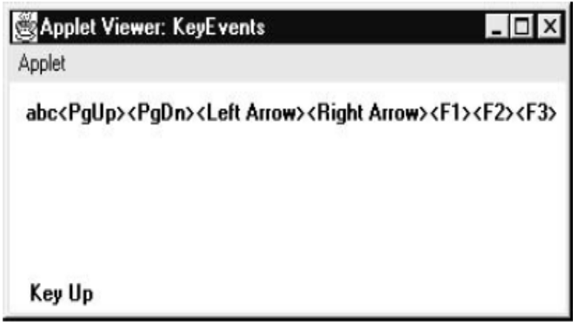
public void keyReleased(KeyEvent ke) { showStatus("Key Up"); } public void keyTyped(KeyEvent ke) { msg += ke.getKeyChar(); repaint(); } public void paint(Graphics g) { g.drawString(msg, X, Y); } }

Slide 144
Syllabus
I/O Basics
  Byte Streams and Character Streams
  Reading Console Input
Collections Framework
Applets & Applet Architecture
  Applet Skelton
  Passing Parameters to Applet
Event Handling
  Event Model
  Event Classes
  Event Listener Interfaces
AWT
  AWT Classes
  AWT Controls
  Layout Managers and Menus.
Swing
  JApplet
  Jbuttons
  JTables

Slide 145
Abstract Window Toolkit-AWT
The AWT contains numerous classes and methods that allow us to create and manage windows.
AWT Classes :
  The AWT classes are contained in the java.awt package.

Slide 146
Some AWT Classes
Class | Description
AWTEvent | Encapsulates AWT events.
AWTEventMulticaster | Dispatches events to multiple listeners.
BorderLayout | The border layout manager. Border layouts use five components: North, South, East, West, and Center.
Button | Creates a push button control.
Canvas | A blank, semantics-free window.
CardLayout | The card layout manager. Card layouts emulate index cards. Only the one on top is showing.
Checkbox | Creates a check box control.
CheckboxGroup | Creates a group of check box controls.
CheckboxMenuItem | Creates an on/off menu item.
Choice | Creates a pop-up list.
Color | Manages colors in a portable, platform-independent fashion.
Component | An abstract superclass for various AWT components.
Container | A subclass of Component that can hold other components.
Cursor | Encapsulates a bitmapped cursor.
Dialog | Creates a dialog window.
Dimension | Specifies the dimensions of an object. The width is stored in width, and the height is stored in height.
Event | Encapsulates events.
EventQueue | Queues events.
FileDialog | Creates a window from which a file can be selected.
FlowLayout | The flow layout manager. Flow layout positions components left to right, top to bottom.
Font | Encapsulates a type font.
FontMetrics | Encapsulates various information related to a font. This information helps you display text in a window.
Frame | Creates a standard window that has a title bar, resize corners, and a menu bar.
Graphics | Encapsulates the graphics context. This context is used by the various output methods to display output in a window.
GraphicsDevice | Describes a graphics device such as a screen or printer.
GraphicsEnvironment | Describes the collection of available Font and GraphicsDevice objects.

Slide 147
Some AWT Classes(Cond..)
Class | Description
GridBagConstraints | Defines various constraints relating to the GridBagLayout class.
GridBagLayout | The grid bag layout manager. Grid bag layout displays components subject to the constraints specified by GridBagConstraints.
GridLayout | The grid layout manager. Grid layout displays components in a two-dimensional grid.
Image | Encapsulates graphical images.
Insets | Encapsulates the borders of a container.
Label | Creates a label that displays a string.
List | Creates a list from which the user can choose. Similar to the standard Windows list box.
MediaTracker | Manages media objects.
Menu | Creates a pull-down menu.
MenuBar | Creates a menu bar.
MenuComponent | An abstract class implemented by various menu classes.
MenuItem | Creates a menu item.
MenuShortcut | Encapsulates a keyboard shortcut for a menu item.
Panel | The simplest concrete subclass of Container.
Point | Encapsulates a Cartesian coordinate pair, stored in x and y.
Polygon | Encapsulates a polygon.
PopupMenu | Encapsulates a pop-up menu.
PrintJob | An abstract class that represents a print job.
Rectangle | Encapsulates a rectangle.
Robot | Supports automated testing of AWT- based applications.
Scrollbar | Creates a scroll bar control.
ScrollPane | A container that provides horizontal and/or vertical scroll bars for another component.
SystemColor | Contains the colors of GUI widgets such as windows, scroll bars, text, and others.
TextArea | Creates a multiline edit control.
TextComponent | A superclass for TextArea and TextField.
TextField | Creates a single-line edit control.
Toolkit | Abstract class implemented by the AWT.
Window | Creates a window with no frame, no menu bar, and no title.

Slide 148
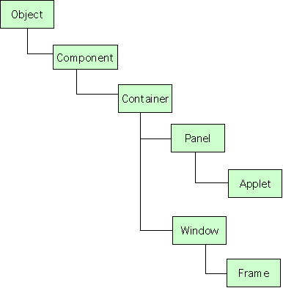
Window Fundamentals
The two most common windows are:
Those derived from Panel, which is used by applets
Those derived from Frame, which creates a standard window

Slide 149
Window Fundamentals
Frame( ) : Creates a standard window
windowFrame(String title) : Creates a window with title
void setSize(int newWidth, int newHeight) : To set the dimensions of the window.
void setSize(Dimension newSize) : Dimension object is passed. It contains width and height fields.
Dimension getSize( ) : To obtain the current size of a window
void setVisible(boolean visibleFlag) : To visible a newly created window.
void setTitle(String newTitle) : To change window title
Closing a Frame Window : Call setVisible(false) followed by windowClosing( )

Slide 150
AWT Controls
Controls are components that allow a user to interact with the application invarious ways.
The AWT supports the following types of controls:
  Labels
  Push buttons
  Check boxes
  Check box groups(Radio buttons)
  Choice lists
  Lists
  Scroll bars
  Text Field
  Text Area

Slide 151
AWT Controls
Adding Controls
  Create an instance of the desired control
  Add it to a window by calling add( )
  Component add(Component compObj)
  compObjis an instance of the control that we want to add
Removing Controls
  Call remove( )
  void remove(Component obj)
  objis a reference to the control that we want to remove.
  Remove all controls by calling removeAll( ).

Slide 152
AWT Controls
Responding to Controls
  Labels are passive controls
  Except for labels, all controls generate events when they are accessed by the user.
  The program simply implements the appropriate interface and then registers an event listener for each control that we need to monitor.

Slide 153
Labels
A label contains a string, which it displays.
Labels are passive controls that do not support any interaction with the user.
Label defines the following constructors:
  Label( ) : Creates a blank label
  Label(String str) :Creates a label that contains the string str
  Label(String str, int how) : Creates a label that contains string str how - Label.LEFT, Label.RIGHT, or Label.CENTER
voidsetText(String str) :To set or change the text in a label.
String getText( ) :To obtain the current label
void setAlignment(inthow) : To set the alignment of the string
int getAlignment( ) : To obtain the current alignment

Slide 154
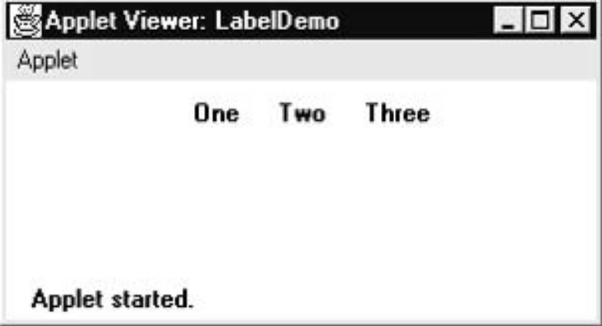
importjava.awt.*; importjava.applet.*; /* <applet code="LabelDemo" width=300 height=200> </applet> */ public class LabelDemo extends Applet { public void init() { Label l1 = new Label("One"); Label l2 = new Label("Two"); Label l3 = new Label("Three"); add(l1); add(l2); add(l3); } }

Slide 155
Push Buttons
A push button contains a label and that generates an event when it is pressed.
This is sent to any listeners that previously registered an interest in receiving action event notifications from that component.
Each listener implements the ActionListener interface. That interface defines the actionPerformed( ) method, which is called when an event occurs. An ActionEvent object is supplied as the argument to this method.
Button defines two constructors:
  Button( ) :Creates an empty button
  Button(String str) :Creates a button that contains str as a label
void setLabel(String str) :To set label of the button
String getLabel( ) : To retrieve the label

Slide 156
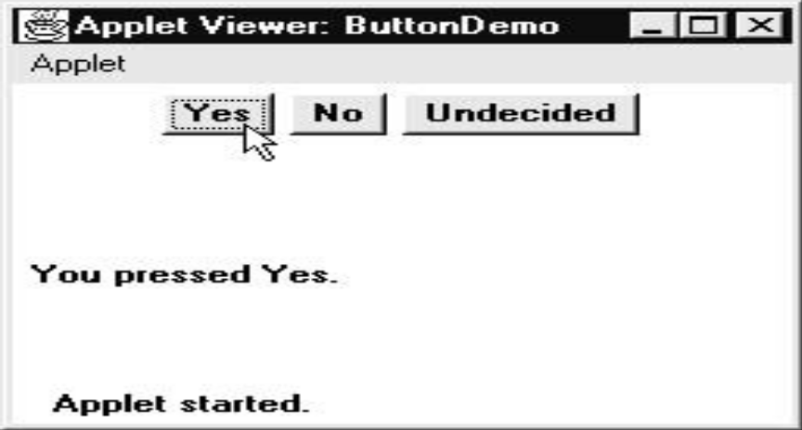
importjava.awt.*; importjava.awt.event.*; importjava.applet.*; /* <applet code="ButtonDemo" width=250 height=150> </applet> */ public class ButtonDemo extends Applet implements ActionListener { String msg = ""; Button b1,b2,b3; public void init() { b1 = new Button("Yes"); b2 = new Button("No"); b3 = new Button("Undecided"); add(b1); add(b2); add(b3); b1.addActionListener(this); b2.addActionListener(this); b3.addActionListener(this); }
public void actionPerformed(ActionEvent ae) { String str = ae.getActionCommand(); if(str.equals("Yes")) { msg = "You pressed Yes."; } else if(str.equals("No")) { msg = "You pressed No."; } else { msg = "You pressed Undecided."; } repaint(); } public void paint(Graphics g) { g.drawString(msg, 6, 100); } }

Slide 157
Check Boxes
It consists of a small box that can either contain a check mark or not.
A label is associated with each checkbox
A check box is a control that is used to turn an option on or off.
Check boxes can be used individually or as part of a group
Checkbox supports these constructors:
  Checkbox( ) : label - initially blank, state - unchecked
  Checkbox(String str) : label – str, state - unchecked
  Checkbox(String str, Boolean on) : label – str, on is true- checked , on is false- unchecked
  Checkbox(String str, Boolean on, CheckboxGroup cbGroup) : label – str, group – cbGroup(If this check box is not part of a group, then cbGroupmust be null)
  Checkbox(String str, CheckboxGroup cbGroup, Boolean on)

Slide 158
Check Boxes
boolean getState( ) :To retrieve the current state of a check box
void setState(booleanon):To set the current state of a check box
String getLabel( ) : To obtain the current label
void setLabel(String str) : To set the label
Each time a check box is selected or deselected, an item event is generated.
This is sent to any listeners that previously registered an interest in receiving item event notifications from that component.
Each listener implements the ItemListener interface. That interface defines the itemStateChanged( ) method. An ItemEvent object is supplied as the argument to this method.

Slide 159
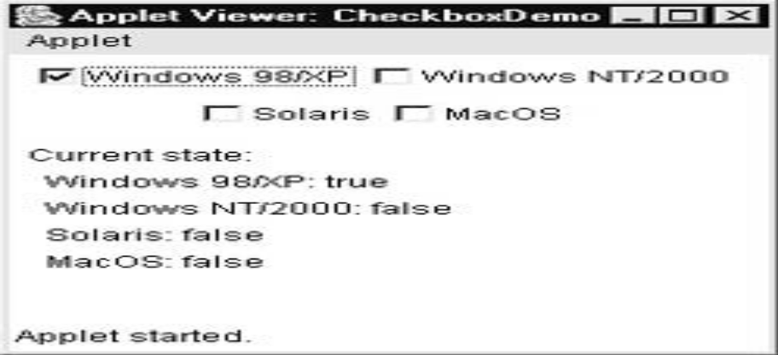
importjava.awt.*; importjava.awt.event.*; importjava.applet.*; /*<applet code="CheckboxDemo" width=250 height=200> </applet> */ public class CheckboxDemo extends Applet implements ItemListener { String msg = ""; Checkbox c1, c2,c3,c4; public void init() { c1=new Checkbox("Windows 98/XP",null, true); c2 = new Checkbox("Windows NT/2000"); c3= new Checkbox("Solaris"); c4 = new Checkbox("MacOS"); add(c1); add(c2); add(c3); add(c4); c1.addItemListener(this); c2.addItemListener(this); c3.addItemListener(this); c4.addItemListener(this); }
public void itemStateChanged(ItemEvent ie) { repaint(); } public void paint(Graphics g) { msg = "Current state: "; g.drawString(msg, 6, 80); msg = " Windows 98/XP: " + c1.getState(); g.drawString(msg, 6, 100); msg = " Windows NT/2000: " + c2.getState(); g.drawString(msg, 6, 120); msg = " Solaris: " + c3.getState(); g.drawString(msg, 6, 140); msg = " MacOS: " + c4.getState(); g.drawString(msg, 6, 160); } }

Slide 160
CheckboxGroup
Used to create a set of mutually exclusive check boxes in which one and only one check box in the group can be checked at any one time.
  First define the group to which they will belong
  Then specify that group when you construct the check boxes
These check boxes are often called radio buttons.
Checkbox getSelectedCheckbox( ) : Determine which check box in a group is currently selected
void setSelectedCheckbox(Checkbox which) :To set a check box. Here, which is the check box that you want to be selected. The previously selected checkbox will be turned off.

Slide 161
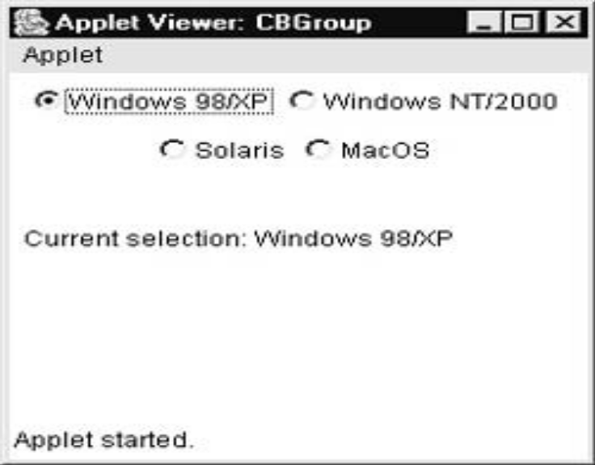
importjava.awt.*; importjava.awt.event.*; importjava.applet.*; /* <applet code="CBGroup" width=250 height=200> </applet> */ public class CBGroup extends Applet implements ItemListener { String msg = ""; Checkbox c1,c2,c3,c4; CheckboxGroup cbg; public void init() { cbg = new CheckboxGroup(); c1 = new Checkbox("Windows 98/XP", cbg, true); c2 = new Checkbox("Windows NT/2000", cbg, false); c3 = new Checkbox("Solaris", cbg, false); c4 = new Checkbox("MacOS", cbg, false); add(c1); add(c2); add(c3); add(c4); c1.addItemListener(this); c2.addItemListener(this); c3.addItemListener(this); c4.addItemListener(this); }
public void itemStateChanged(ItemEvent ie) { repaint(); } // Display current state of the check boxes. public void paint(Graphics g) { msg = "Current selection: "; msg += cbg.getSelectedCheckbox().getLabel(); g.drawString(msg, 6, 100); } }

Slide 162
Choice Lists
The Choice class is used to create a pop-up list of items from which the user may choose.
When the user clicks on choice, the whole list of choices pops up, and a new selection can be made.
Choice constructor creates an empty list
void add(String name) : To add a selection to the list
String getSelectedItem( ) :Returns currently selected string
int getSelectedIndex( ) : Returns the index of the currently selected item. The first item is at index 0
getItemCount( ) :To obtain the number of items in the list
void select(int index) : Set the currently selected item
void select(String name) : Set the currently selected item
String getItem(int index) : To obtain the name associated with the item

Slide 163
Choice Lists
Each time a choice is selected, an item event is generated.
This is sent to any listeners that previously registered an interest in receiving item event notifications from that component.
Each listener implements the ItemListener interface. That interface defines the itemStateChanged( ) method. An ItemEvent object is supplied as the argument to this method.

Slide 164
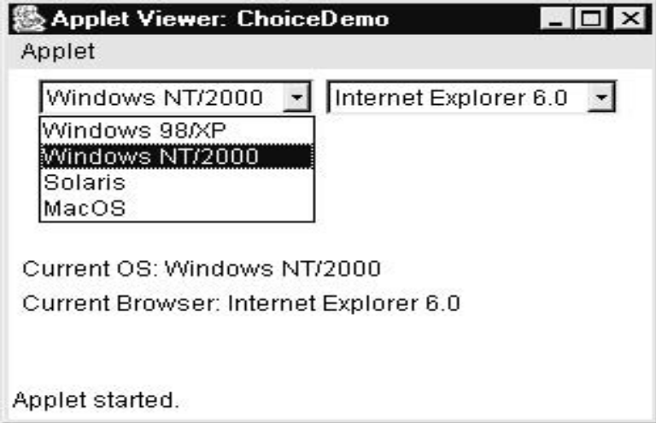
importjava.awt.*; importjava.awt.event.*; importjava.applet.*; /* <applet code="ChoiceDemo" width=300 height=180> </applet> */ public class ChoiceDemo extends Applet implements ItemListener { Choice os, browser; String msg = ""; public void init() { os = new Choice(); browser = new Choice(); os.add("Windows 98/XP"); os.add("Windows NT/2000"); os.add("Solaris"); os.add("MacOS"); browser.add("Netscape 3.x"); browser.add("Netscape 4.x"); browser.add("Netscape 5.x"); browser.add("Netscape 6.x"); browser.add("Internet Explorer 4.0"); browser.add("Internet Explorer 5.0"); browser.add("Internet Explorer 6.0"); browser.add("Lynx 2.4"); browser.select("Netscape 4.x");
add(os); add(browser); os.addItemListener(this); browser.addItemListener(this); } public void itemStateChanged(ItemEvent ie) { repaint(); } public void paint(Graphics g) { msg = "Current OS: "; msg += os.getSelectedItem(); g.drawString(msg, 6, 120); msg = "Current Browser: "; msg += browser.getSelectedItem(); g.drawString(msg, 6, 140); } }

Slide 165
Lists
It provides a compact, multiple-choice, scrolling selection list.
It can be created to allow multiple selections.
List constructors are:
  List( ) : Allows to select only one item at a time
  List(int numRows) :numRows specifies the number of entries in the list that will always be visible
  List(int numRows, boolean multipleSelect) : If multipleSelectis true, then the user may select two or more items at a time. If it is false, then only one item may be selected
void add(String name) : Adds items to the end of the list.
void add(String name, int index) : Adds the item at the index specified by index. Indexing begins at zero. You can specify –1 to add the item to the end of the list.

Slide 166
Lists
For lists that allow only single selection:
  String getSelectedItem( ) : Returns a string containing the name of the selected item.
  int getSelectedIndex( ) : Returns the index of the selected item.
For lists that allow multiple selection:
  String[ ] getSelectedItems( ) : Returns an array containing the names of the currently selected items
  int[ ] getSelectedIndexes( ) : Returns an array containing the indexes of the currently selected items.
int getItemCount( ) : To obtain the number of items in the list
void select(int index) : To set the currently selected item
String getItem(int index) : To obtain the name associated with the item at that index

Slide 167
Lists
Need to implement the ActionListener interface.
Each time a List item is double-clicked, an ActionEvent object is generated.
Its getActionCommand( ) method can be used to retrieve the name of the newly selected item.
Also, each time an item is selected or deselected with a single click, an ItemEvent object is generated.
Its getStateChange( ) method can be used to determine whether a selection or deselection triggered this event. getItemSelectable( ) returns a reference to the object that triggered this event.

Slide 168
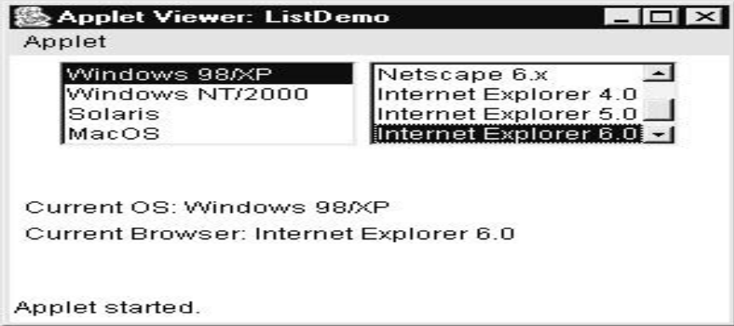
importjava.awt.*; importjava.awt.event.*; importjava.applet.*; /*<applet code="ListDemo" width=300 height=180> </applet> */ public class ListDemo extends Applet implements ActionListener { List os, browser; String msg = ""; public void init() { os = new List(4, true); browser = new List(4, false); os.add("Windows 98/XP"); os.add("Windows NT/2000"); os.add("Solaris"); os.add("MacOS"); browser.add("Netscape 3.x"); browser.add("Netscape 4.x"); browser.add("Netscape 5.x"); browser.add("Netscape 6.x"); browser.add("Internet Explorer 4.0"); browser.add("Internet Explorer 5.0"); browser.add("Internet Explorer 6.0"); browser.add("Lynx 2.4"); browser.select(1);
add(os); add(browser); os.addActionListener(this); browser.addActionListener(this); } public void actionPerformed(ActionEvent ae) { repaint(); } public void paint(Graphics g) { int idx[]; msg = "Current OS: "; idx = os.getSelectedIndexes(); for(inti=0; i<idx.length; i++) msg += os.getItem(idx[i]) + " "; g.drawString(msg, 6, 120); msg = "Current Browser: "; msg += browser.getSelectedItem(); g.drawString(msg, 6, 140); } }

Slide 169
Scroll Bars
Scroll bars are used to select continuous values between a specified minimum and maximum.
Scroll bars may be oriented horizontally or vertically.
The current value of the scroll bar relative to its minimum and maximum values is indicated by the slider box (or thumb) for the scroll bar.
Scrollbar defines the following constructors:
  Scrollbar( ) : Creates a vertical scroll bar
  Scrollbar(int style) : style - Scrollbar.VERTICAL,
  Scrollbar.HORIZONTAL
  Scrollbar(int style, int initialValue, int thumbSize, int min, int max):
initialValue - initial value of the scroll bar
thumbSize - height of the thumb
min and max - minimum and maximum values of the scroll bar

Slide 170
Scroll Bars
void setValues(int initialValue, int thumbSize, int min, int max) :
to set parameters
int getValue( ) : To obtain the current value of the scroll bar
void setValue(int newValue) : To set the current value
int getMinimum( ) : Retrieve the minimum value
int getMaximum( ) : Retrieve the maximum value
void setUnitIncrement(intnewIncr): scrolled up/down one line
void setBlockIncrement(intnewIncr): page-up/page-down increments are 10

Slide 171
Scroll Bars
Implement the AdjustmentListener interface.
Each time a user interacts with a scroll bar, an AdjustmentEvent object is generated.
Its getAdjustmentType() method can be used to determine the type of the adjustment.
  BLOCK_DECREMENT: A page-down event has been generated.
  BLOCK_INCREMENT: A page-up event has been generated.
  TRACK : An absolute tracking event has been generated.
  UNIT_DECREMENT: The line-down button in a scroll bar has been pressed.
  UNIT_INCREMENT : The line-up button in a scroll bar has been pressed.

Slide 172
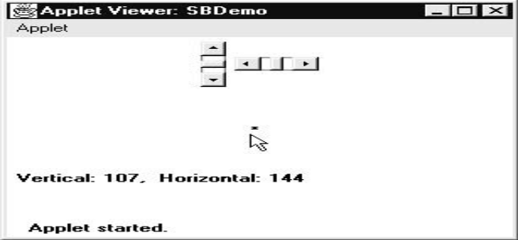
importjava.awt.*; importjava.awt.event.*; importjava.applet.*; /* <applet code="SBDemo" width=300 height=200> </applet> */ public class SBDemo extends Applet implements AdjustmentListener, MouseMotionListener { String msg = ""; Scrollbar vertSB, horzSB; public void init() {int width = Integer.parseInt(getParameter("width")); int height = Integer.parseInt(getParameter("height")); vertSB = new Scrollbar(Scrollbar.VERTICAL, 0, 1, 0, height); horzSB = new Scrollbar(Scrollbar.HORIZONTAL, 0, 1, 0, width); add(vertSB); add(horzSB); vertSB.addAdjustmentListener(this); horzSB.addAdjustmentListener(this); addMouseMotionListener(this); }
public void adjustmentValueChanged (AdjustmentEvent ae) { repaint(); } public void mouseDragged(MouseEvent me) { int x = me.getX(); int y = me.getY(); vertSB.setValue(y); horzSB.setValue(x); repaint(); } public void mouseMoved(MouseEvent me) { } public void paint(Graphics g) { msg = "Vertical: " + vertSB.getValue(); msg += ", Horizontal: " + horzSB.getValue(); g.drawString(msg, 6, 160); g.drawString("*", horzSB.getValue(), vertSB.getValue()); } }

Slide 173
TextField
Text fields allow the user to enter strings and to edit the text using the arrow keys, cut and paste keys, and mouse selections.
TextField constructors:
  TextField( ) : Creates a default text field
  TextField(int numChars) : numChars – size of text field
  TextField(String str) : Initializes the text field with the string
  TextField(String str, int numChars): Initializes a text field and sets its width
String getText( ) : To obtain the current string in the text field
void setText(String str) : To set the text
String getSelectedText( ) : Obtain the currently selected text
void select(int startIndex, int endIndex): Select a portion of text

Slide 174
TextField
boolean isEditable( ) :Determine editability of the text field.
void setEditable(boolean canEdit): To set the editabitilty
void setEchoChar(char ch) : disable the echoing of the characters. ch - character to be echoed
boolean echoCharIsSet( ) : Echo set mode is activated or not
char getEchoChar( ) : Retrieve the echo character
Text fields respond when the user presses ENTER.
When this occurs, an action event is generated.

Slide 175
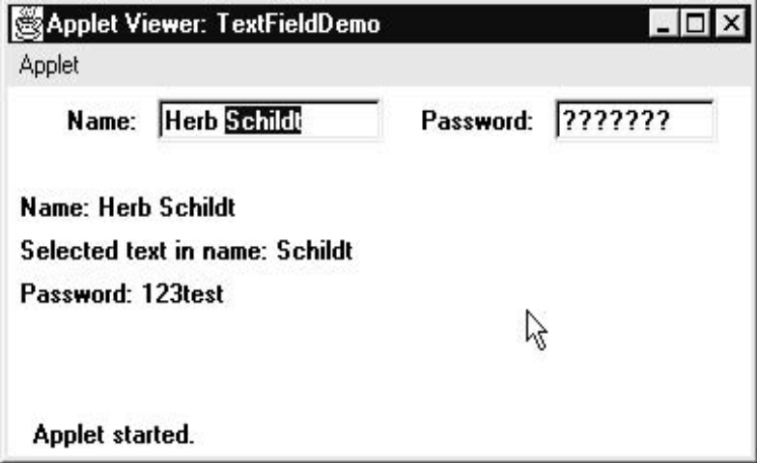
importjava.awt.*; importjava.awt.event.*; importjava.applet.*; /* <applet code="TextFieldDemo" width=380 height=150> </applet> */ public class TextFieldDemo extends Applet implements ActionListener { TextField t1,t2; public void init() { Label l1 = new Label("Name: ", Label.RIGHT); Label l2 = new Label("Password: ", Label.RIGHT); t1 = new TextField(12); t2 = new TextField(8); t2.setEchoChar('?'); add(l1); add(t1); add(l2); add(t2); t1.addActionListener(this); t2.addActionListener(this); }
// User pressed Enter. public void actionPerformed(ActionEvent ae) { repaint(); } public void paint(Graphics g) { g.drawString("Name: " + t1.getText(), 6, 60); g.drawString("Selected text in name: " + t1.getSelectedText(), 6, 80); g.drawString("Password: " + t2.getText(), 6, 100); } }

Slide 176
TextArea
TextArea is a multiline editor.
Constructors for TextArea are:
  TextArea( )
  TextArea(int numLines, int numChars): numLines – height, numChars - width
  TextArea(String str) : str - Initial text
  TextArea(String str, int numLines, int numChars)
  TextArea(String str, int numLines, int numChars, int sBars) :
  sBars - SCROLLBARS_BOTH SCROLLBARS_NONE SCROLLBARS_HORIZONTAL_ONLY
  SCROLLBARS_VERTICAL_ONLY

Slide 177
TextArea
getText( )
setText( )
getSelectedText( )
select( )
isEditable( )
setEditable( )
void append(String str)
void insert(String str, int index)
void replaceRange(String str, int startIndex, int endIndex)

Slide 178
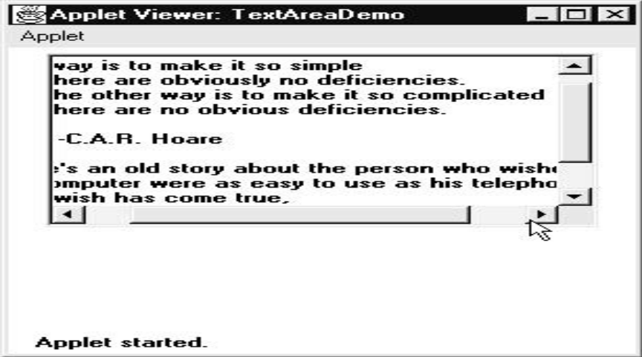
importjava.awt.*; importjava.applet.*; /* <applet code="TextAreaDemo" width=300 height=250> </applet> */ public class TextAreaDemo extends Applet { public void init() { String val = "There are two ways of constructing " + "a software design.\n" + "One way is to make it so simple\n" + "that there are obviously no deficiencies.\n" + "And the other way is to make it so complicated\n" + "that there are no obvious deficiencies.\n\n" + " -C.A.R. Hoare\n\n" + "There's an old story about the person who wished\n" + "his computer were as easy to use as his telephone.\n" + "That wish has come true,\n" + "since I no longer know how to use my telephone.\n\n" + " -BjarneStroustrup, AT&T, (inventor of C++)"; TextArea text = new TextArea(val, 10, 30); add(text); } }

Slide 179
import java.awt.*; import java.applet.*; /* <applet code="TextAreaDemo" width=300 height=250> </applet> */ public class TextAreaDemo extends Applet { public void init() { String val = "There are two ways of constructing " + "a software design.\n" + "One way is to make it so simple\n" + "that there are obviously no deficiencies.\n" + "And the other way is to make it so complicated\n" + "that there are no obvious deficiencies.\n\n" + " -C.A.R. Hoare\n\n" + "There's an old story about the person who wished\n" + "his computer were as easy to use as his telephone.\n" + "That wish has come true,\n" + "since I no longer know how to use my telephone.\n\n" + " -BjarneStroustrup, AT&T, (inventor of C++)"; TextArea text = new TextArea(val, 10, 30); add(text); } }

Slide 180
Layout Managers
Layout manager automatically arranges controls within a window by using some type of algorithm.
Different Layout Managers are:
  Flow Layout
  Border Layout
  Grid Layout
  Card Layout

Slide 181
Layout Managers
To set layout manager:
void setLayout(LayoutManager layoutObj)
Here, layoutObj is a reference to the desired layout manager.
If no call to setLayout( ) is made, then the default layout manager is used.
Each container has a layout manager
Whenever a container is resized, the layout manager is used to position each of the components within it.

Slide 182
Flow Layout
FlowLayout is the default layout manager.
Components are laid out from the upper-left corner, left to right and top to bottom.
Constructors are:
  FlowLayout( ) : Centers components and leaves 5 pixels of space between each component
  FlowLayout(int how) : specify how each line is aligned
  FlowLayout.LEFT FlowLayout.CENTER FlowLayout.RIGHT
  FlowLayout(int how, int horz, int vert): Specify the horizontal and vertical space left between components

Slide 183
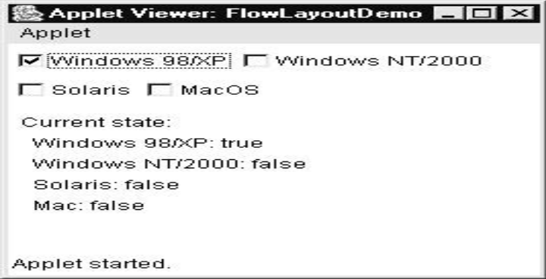
import java.awt.*; import java.awt.event.*; import java.applet.*; /*<applet code="FlowLayoutDemo" width=250 height=200> </applet> */ public class FlowLayoutDemo extends Applet implements ItemListener { String msg = ""; Checkbox Win98, winNT, solaris, mac; public void init() {setLayout(new FlowLayout(FlowLayout.LEFT)); Win98 = new Checkbox("Windows 98/XP", null, true); winNT = new Checkbox("Windows NT/2000"); solaris = new Checkbox("Solaris"); mac = new Checkbox("MacOS"); add(Win98); add(winNT); add(solaris); add(mac); Win98.addItemListener(this); winNT.addItemListener(this); solaris.addItemListener(this); mac.addItemListener(this); }
public void itemStateChanged(ItemEvent ie) { repaint(); } public void paint(Graphics g) { msg = "Current state: "; g.drawString(msg, 6, 80); msg = " Windows 98/XP: " + Win98.getState(); g.drawString(msg, 6, 100); msg = " Windows NT/2000: " + winNT.getState(); g.drawString(msg, 6, 120); msg = " Solaris: " + solaris.getState(); g.drawString(msg, 6, 140); msg = " Mac: " + mac.getState(); g.drawString(msg, 6, 160); } }

Slide 184
Border Layout
It has four narrow, fixed-width components at the edges and one large area in the center.
  BorderLayout.CENTER BorderLayout.SOUTH
  BorderLayout.EAST BorderLayout.WEST BorderLayout.NORTH
Constructors are:
  BorderLayout( ) : Creates a default border layout
  BorderLayout(int horz, int vert) : horz and vert specifies the horizontal and vertical space left between components
To add components:
  void add(Component compObj, Object region);
  compObj - component to be added
  region - where the component will be added.

Slide 185
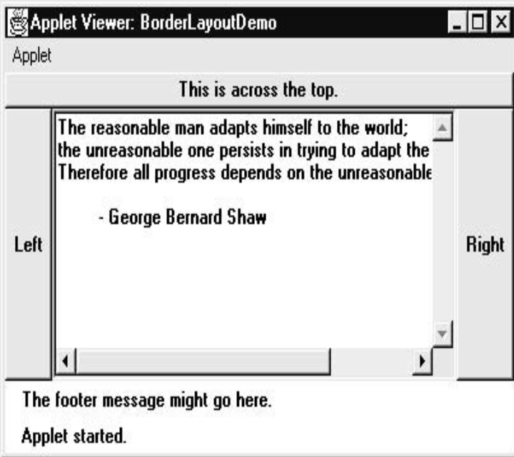
import java.awt.*; import java.applet.*; import java.util.*; /* <applet code="BorderLayoutDemo" width=400 height=200> </applet> */ public class BorderLayoutDemo extends Applet { public void init() { setLayout(new BorderLayout()); add(new Button("This is across the top."), BorderLayout.NORTH); add(new Label("The footer message might go here."), BorderLayout.SOUTH); add(new Button("Right"), BorderLayout.EAST); add(new Button("Left"), BorderLayout.WEST); String msg = "The reasonable man adapts " + "himself to the world;\n" + "the unreasonable one persists in " + "trying to adapt the world to himself.\n" + "Therefore all progress depends " + "on the unreasonable man.\n\n" + " - George Bernard Shaw\n\n"; add(new TextArea(msg), BorderLayout.CENTER); } }

Slide 186
Grid Layout
GridLayout lays out components in a two-dimensional grid(defines number of rows and columns).
Constructors are:
  GridLayout( ) : Creates a single-column grid layout
  GridLayout(int numRows, int numColumns ) : Creates a grid layout with the specified number of rows and columns
  GridLayout(int numRows, int numColumns, int horz, int vert) : specify the horizontal and vertical space left between components
  numRows = 0, allows unlimited-length columns
  numColumns =0, allows unlimited-length rows

Slide 187
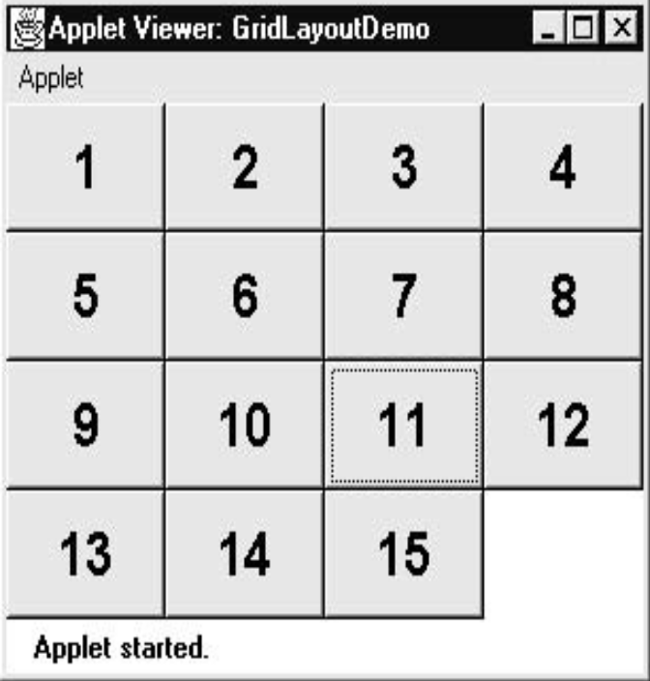
import java.awt.*; import java.applet.*; /* <applet code="GridLayoutDemo" width=300 height=200> </applet> */ public class GridLayoutDemo extends Applet { static final int n = 4; public void init() { setLayout(new GridLayout(n, n)); setFont(new Font("SansSerif", Font.BOLD, 24)); for(int i = 0; i < n; i++) { for(int j = 0; j < n; j++) { int k = i * n + j; if(k > 0) add(new Button("" + k)); } } } }

Slide 188
Card Layout
Constructors:
  CardLayout( ) : Creates a default card layout
  CardLayout(int horz, int vert) : Specify the horizontal and vertical space left between components
Steps:
  Create a panel that contains the deck and a panel for each card in the deck.
  Add to the appropriate panel the components that form each card.
  Add these panels to the panel for which CardLayout is the layout manager.
  Add this panel to the main applet panel.
  Once these steps are complete, we must provide some way for the user to select between cards. One common approach is to include one push button for each card in the deck.

Slide 189
Card Layout
To add a card to the panel :
void add(Component panelObj, Object name);
name - name of the card
panelObj – panel of the card
Methods defined by CardLayout:
  void first(Container deck) : To show the first card
  void last(Container deck) : To show the last card
  void next(Container deck) : To show the next card
  void previous(Container deck) : To show the previous card
  void show(Container deck, String cardName) : To displays the particular card(cardName)
  deck - reference to the container (panel) that holds the cards
  cardName - name of a card.

Slide 190
import java.awt.*; import java.awt.event.*; import java.applet.*; /*<applet code="CardLayoutDemo" width=300 height=100> </applet> */ public class CardLayoutDemo extends Applet implements ActionListener, MouseListener { Checkbox c1,c2,c3,c4; Panel p1; CardLayout cardLO; Button b1,b2; public void init() { b1 = new Button("Windows"); b2 = new Button("Other"); add(b1); add(b2); cardLO = new CardLayout(); p1 = new Panel(); p1.setLayout(cardLO); c1 = new Checkbox("Windows 98/XP", null, true); c2 = new Checkbox("Windows NT/2000"); c3 = new Checkbox("Solaris"); c4 = new Checkbox("MacOS"); Panel p2 = new Panel(); p2.add(c1); p2.add(c2);
Panel p3 = new Panel(); p3.add(c3); p3.add(c4); p1.add(p2, "Windows"); p1.add(p3, "Other"); add(p1); b1.addActionListener(this); b2.addActionListener(this); addMouseListener(this); } public void mousePressed(MouseEvent me) { cardLO.next(p1); } public void mouseClicked(MouseEvent me) { } public void mouseEntered(MouseEvent me) { } public void mouseExited(MouseEvent me) { } public void mouseReleased(MouseEvent me) { } public void actionPerformed(ActionEvent ae) { if(ae.getSource() == b1) { cardLO.show(p1, "Windows"); } else { cardLO.show(p1, "Other"); } } }

Slide 191
Menu
Menu is implemented by using the following classes:
  MenuBar
  Menu
  MenuItem
A menu bar contains one or more Menu objects.
Each Menu object contains a list of MenuItem objects. Each MenuItem object represents something that can be selected by the user.
Checkable menu items are also possible

Slide 192
Menu
Constructors for Menu:
  Menu( ) : Creates an empty menu
  Menu(String optionName) : optionName - name of the menu
  Menu(String optionName, boolean removable)

Slide 193
Menu
Constructors of MenuItem :
  MenuItem( )
  MenuItem(String itemName) : itemName - name shown in the menu
  MenuItem(String itemName, MenuShortcut keyAccel) :
  keyAccel - menu shortcut
void setEnabled(boolean enabledFlag) : To disable or enable a menu item
boolean isEnabled( ) : To determine an item’s status
void setLabel(String newName) : To change the name of a menu item
String getLabel( ): To retrieve the current name of a menu item

Slide 194
Menu
Constructors of CheckboxMenuItem are:
  CheckboxMenuItem( )
  CheckboxMenuItem(String itemName): itemName - name shown in the menu
  CheckboxMenuItem(String itemName, boolean on)
boolean getState( ) : To obtain the status of a checkable item
void setState(boolean checked) : To set the status of a checkable item

Slide 195
Menu
To add the menu item to a Menu object:
MenuItem add(MenuItem item)
To add menu object to the menu bar :
Menu add(Menu menu)
Each time a menu item is selected, an ActionEvent object is generated. We must implement the ActionListener interfaces
Each time a check box menu item is checked or unchecked, an ItemEvent object is generated. We must implement the ItemListener interfaces.

Slide 196
import java.awt.*; import java.awt.event.*; import java.applet.*; /* <applet code="MenuDemo" width=250 height=250> </applet> */ class MenuFrame extends Frame { String msg = ""; CheckboxMenuItem debug, test; MenuFrame(String title) { super(title); MenuBar mbar = new MenuBar(); setMenuBar(mbar); Menu file = new Menu("File"); MenuItem item1, item2, item3, item4, item5; file.add(item1 = new MenuItem("New...")); file.add(item2 = new MenuItem("Open...")); file.add(item3 = new MenuItem("Close")); file.add(item4 = new MenuItem("-")); file.add(item5 = new MenuItem("Quit...")); mbar.add(file); Menu edit = new Menu("Edit"); MenuItem item6, item7, item8, item9; edit.add(item6 = new MenuItem("Cut")); edit.add(item7 = new MenuItem("Copy")); edit.add(item8 = new MenuItem("Paste")); edit.add(item9 = new MenuItem("-"));
Menu sub = new Menu("Special"); MenuItem item10, item11, item12; sub.add(item10 = new MenuItem("First")); sub.add(item11 = new MenuItem("Second")); sub.add(item12 = new MenuItem("Third")); edit.add(sub); debug = new CheckboxMenuItem("Debug"); edit.add(debug); test = new CheckboxMenuItem("Testing"); edit.add(test); mbar.add(edit); MyMenuHandler handler = new MyMenuHandler(this); item1.addActionListener(handler); item2.addActionListener(handler); item3.addActionListener(handler); item4.addActionListener(handler); item5.addActionListener(handler); item6.addActionListener(handler); item7.addActionListener(handler); item8.addActionListener(handler); item9.addActionListener(handler); item10.addActionListener(handler); item11.addActionListener(handler); item12.addActionListener(handler); debug.addItemListener(handler); test.addItemListener(handler);

Slide 197
MyWindowAdapter adapter = new MyWindowAdapter(this); addWindowListener(adapter); } public void paint(Graphics g) { g.drawString(msg, 10, 200); if(debug.getState()) g.drawString("Debug is on.", 10, 220); else g.drawString("Debug is off.", 10, 220); if(test.getState()) g.drawString("Testing is on.", 10, 240); else g.drawString("Testing is off.", 10, 240); } } class MyWindowAdapter extends WindowAdapter { MenuFrame menuFrame; public MyWindowAdapter(MenuFrame menuFrame) { this.menuFrame = menuFrame; } public void windowClosing(WindowEvent we) { menuFrame.setVisible(false); } }

Slide 198
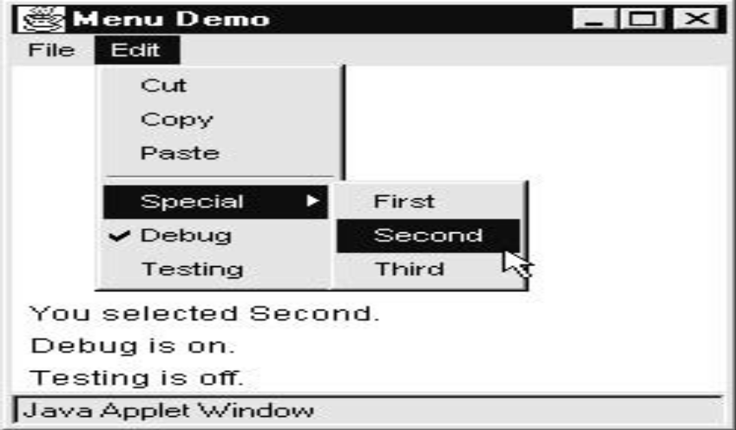
class MyMenuHandler implements ActionListener, ItemListener { MenuFrame menuFrame; public MyMenuHandler(MenuFrame menuFrame) { this.menuFrame = menuFrame; } public void actionPerformed(ActionEvent ae) { String msg = "You selected "; String arg = (String)ae.getActionCommand(); if(arg.equals("New...")) msg += "New."; else if(arg.equals("Open...")) msg += "Open."; else if(arg.equals("Close")) msg += "Close."; else if(arg.equals("Quit...")) msg += "Quit."; else if(arg.equals("Edit")) msg += "Edit."; else if(arg.equals("Cut")) msg += "Cut."; else if(arg.equals("Copy")) msg += "Copy."; else if(arg.equals("Paste")) msg += "Paste."; else if(arg.equals("First")) msg += "First."; else if(arg.equals("Second")) msg += "Second."; else if(arg.equals("Third")) msg += "Third."; else if(arg.equals("Debug")) msg += "Debug."; else if(arg.equals("Testing")) msg += "Testing."; menuFrame.msg = msg; menuFrame.repaint(); } public void itemStateChanged(ItemEvent ie) { menuFrame.repaint(); } }
public class MenuDemo extends Applet { Frame f; public void init() { f = new MenuFrame("Menu Demo"); int width = Integer.parseInt(getParameter("width")); int height = Integer.parseInt(getParameter("height")); setSize(new Dimension(width, height)); f.setSize(width, height); f.setVisible(true); } public void start() { f.setVisible(true); } public void stop() { f.setVisible(false); } }

Slide 199
Syllabus
I/O Basics
  Byte Streams and Character Streams
  Reading Console Input
Collections Framework
Applets & Applet Architecture
  Applet Skelton
  Passing Parameters to Applet
Event Handling
  Event Model
  Event Classes
  Event Listener Interfaces
AWT
  AWT Classes
  AWT Controls
  Layout Managers and Menus.
Swing
  JApplet
  Jbuttons
  JTables

Slide 200
Swings
The Swing-related classes are contained in javax.swing.
Swing is a set of classes that provides more powerful and flexible components than are possible with the AWT.
All components have more capabilities in Swing.
Example: A button may have both an image and a text string associated with it. Also, the image can be changed as the state of the button changes.
Swings are platform-independent because it is written entirely in Java.
Some Swing component classes are:
  JApplet
  JButton
  JTable

Slide 201
JApplet
Applets that use Swings must be subclasses of JApplet.
Difference between Applet and JApplet :
  When adding a component to an instance of JApplet, call add( ) for the content pane of the JApplet object.
The content pane can be obtained by:
Container getContentPane( )
To add a component to a content pane:
void add(comp)
comp - component to be added to the content pane

Slide 202
JButton
The JButton class provides the functionality of a push button.
JButton allows an icon, a string, or both to be associated with the push button.
Some of its constructors are shown here:
  JButton(Icon i)
  JButton(String s)
  JButton(String s, Icon i)
  Here, s and i are the string and icon used for the button.

Slide 203
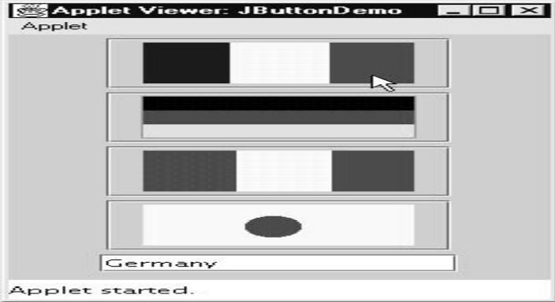
import java.awt.*; import java.awt.event.*; import javax.swing.*; /*<applet code="JButtonDemo" width=250 height=300> </applet> */ public class JButtonDemo extends JApplet implements ActionListener { JTextField jtf; public void init() { Container contentPane = getContentPane(); contentPane.setLayout(new FlowLayout()); ImageIcon ic1 = new ImageIcon("france.gif"); JButton jb = new JButton(ic1); jb.setActionCommand(“Germany"); jb.addActionListener(this); contentPane.add(jb); ImageIcon ic2 = new ImageIcon("germany.gif"); jb = new JButton(ic2); jb.setActionCommand(“Image-2"); jb.addActionListener(this); contentPane.add(jb);
ImageIcon ic3 = new ImageIcon("italy.gif"); jb = new JButton(ic3); jb.setActionCommand("Image-3"); jb.addActionListener(this); contentPane.add(jb); ImageIcon ic4 = new ImageIcon("japan.gif"); jb = new JButton(ic4); jb.setActionCommand("Image-4"); jb.addActionListener(this); contentPane.add(jb); jtf = new JTextField(15); contentPane.add(jtf); } public void actionPerformed(ActionEvent ae) { jtf.setText(ae.getActionCommand()); } }

Slide 204
JTable
A table is a component that displays rows and columns of data.
Resizing and repositioning of columns are possible.
Tables are implemented by the JTable class, which extends JComponent.
JTable constructor :
  JTable(Object data[ ][ ], Object colHeads[ ])
  data - two-dimensional array of the information to be presented
  colHeads - one-dimensional array with the column headings.
Steps for using a table in an applet:
  Create a JTable object.
  Create a JScrollPane object.
  Add the table to the scroll pane.
  Add the scroll pane to the content pane of the applet.

Slide 205
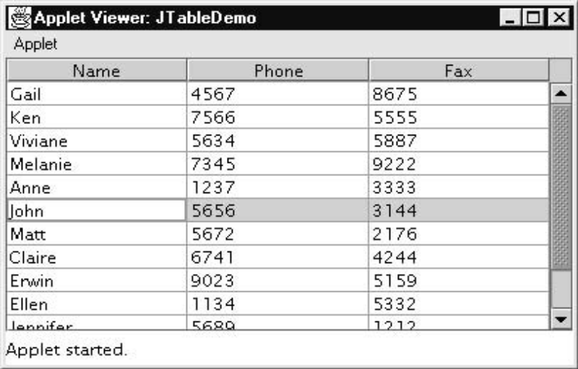
import java.awt.*; import javax.swing.*; /* <applet code="JTableDemo" width=400 height=200> </applet> */ public class JTableDemo extends JApplet { public void init() { Container contentPane = getContentPane(); contentPane.setLayout(new BorderLayout()); final String[] colHeads = { "Name", "Phone", "Fax" }; final Object[][] data = { { "Gail", "4567", "8675" }, { "Ken", "7566", "5555" }, { "Viviane", "5634", "5887" }, { "Melanie", "7345", "9222" }, { "Anne", "1237", "3333" }, { "John", "5656", "3144" }, { "Matt", "5672", "2176" }, { "Claire", "6741", "4244" }, { "Erwin", "9023", "5159" }, { "Ellen", "1134", "5332" }, { "Jennifer", "5689", "1212" }, { "Ed", "9030", "1313" }, { "Helen", "6751", "1415" } }; JTable table = new JTable(data, colHeads); int v = ScrollPaneConstants.VERTICAL_SCROLLBAR_AS_NEEDED; int h = ScrollPaneConstants.HORIZONTAL_SCROLLBAR_AS_NEEDED; JScrollPane jsp = new JScrollPane(table, v, h); contentPane.add(jsp, BorderLayout.CENTER); } }

